Slide 1
The OPEC Fund for International Development
“OFID”
Private Sector & Trade Finance Department
November, 2017

Slide 2
Presentation Highlights
History & Key Characteristics
OFID’s Cumulative Activities
Private Sector & Trade Finance
2

Slide 3
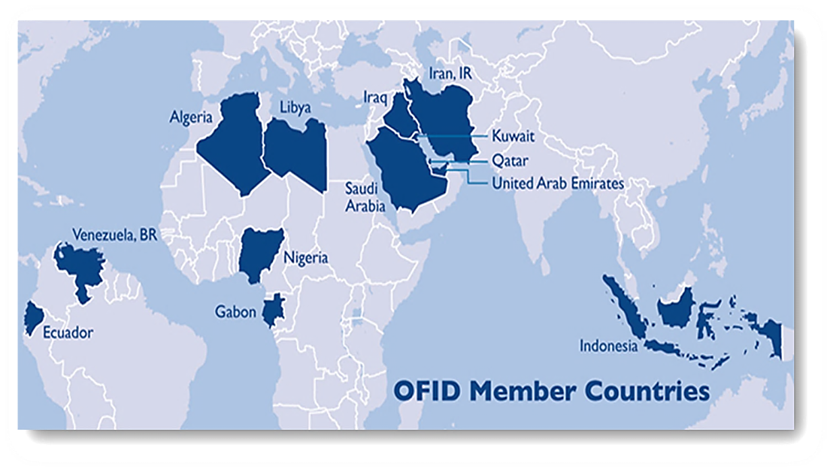
History & Key Characteristics
OFID is the development finance institution established in 1976 by OPEC Member States, as a collective channel for aid to developing countries.
OFID’s aim is to help low income countries in pursuit of sustainable social & economic advancement, and, to promote cooperation between OPEC Member Countries and other developing countries as an expression of South-South solidarity.
OFID finances development projects through three main windows: Public Sector, Private Sector & Trade Finance and Grants.
Global cooperation network of multilateral & bilateral agencies, financial & non-financial institutions.
3

Slide 4
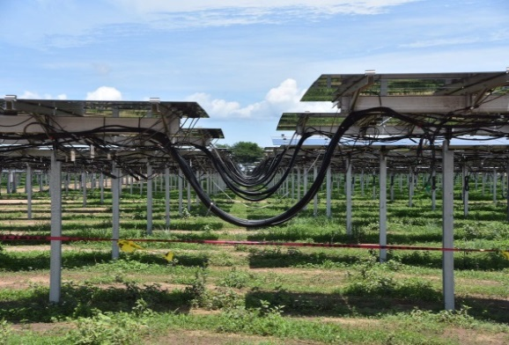
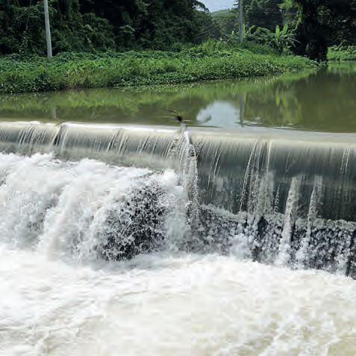
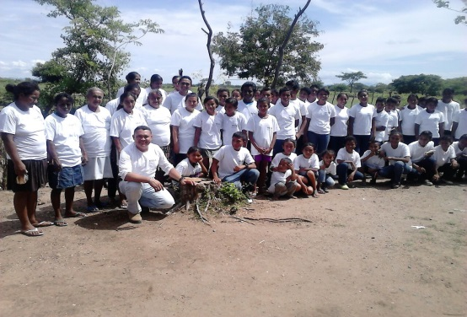
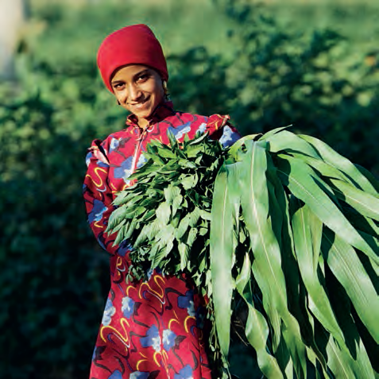
OFID’s Cumulative Activities
Over the last 41 years, OFID has approved over 3,700 operations, totaling US$ 21 Bn, across a range of sectors.
Supported 134 countries worldwide: 53 in Africa, 43 in Asia, 31 in Latin America and 7 in Europe.
Majority of the resources were allocated towards the Energy, Transportation and Agricultural sectors
OFID is strategically positioned to focus on the water-food-energy nexus of sustainable water access, modern energy access and food security.
Mecer Solar Project, Honduras
Maggotty River Hydroelectric Project, Jamaica
Micro-Finance & SMEs
Farm Irrigation Development Project, Egypt
4

Slide 5
PS & TF Eligibility
Country
Eligibility
Global mandate
All low & middle income countries
Client
Eligibility
Private enterprises
Project
Eligibility
AEPIs *
Financial institutions
State-owned enterprises (commercially managed and financially & operationally autonomous)
Project must be: commercially, technically, financially, socially, & environmentally viable, with a clear developmental impact
Visibility to OFID
Additionality
Non-OPEC Member countries
Government and Government Agencies for Trade Finance only
Signed in 68 countries
In force 64 countries
* Agreement for the Encouragement & Protection of Investment (not required for Trade Finance loans)
5

Slide 6
PS & TF Products
Term Loans
Project Finance
Equity
Direct Investments
(FIs)
Guarantees
Trade Finance
(Import Financing/ Risk Sharing Programs)
Corporate Loans
Private Equity
(all sectors)
MSMEs*
Trade Finance (FIs/Structured Commodity)
Private Sector
(Credit Enhancement Scheme)
*MSME Sector includes financing via financial intermediaries including commercial banks, microfinance institutions, leasing companies, development banks, microfinance organisations and housing finance agencies
6

Slide 7
PS & TF Cumulative Activities
Regional Distribution of Net Approvals
Net Approvals by Instrument
7

Slide 8
OFID’s far-reaching global support
OFID has supported 11 Arab Countries via 68 transactions, totalling US$ 1.268 Bn (excluding risk sharing programs) across a diverse range of sectors :
OFID has also partnered with other large financial institutions to provide unfunded risk sharing facilities to 59 banks totalling US$ 595 Mn across the Arab World
OFID also supports companies from OFID/OPEC member countries (e.g. Saudi Arabia/Kuwait/UAE etc) or from non-member countries (e.g. Lebanon/Greece) in their envisaged investments in OFID Beneficiary countries (Arab or non-Arab). Such projects need to meet OFID’s standard eligibility criteria with clear evidence that the financing is providing direct benefit to an eligible OFID Beneficiary country
8

Slide 9
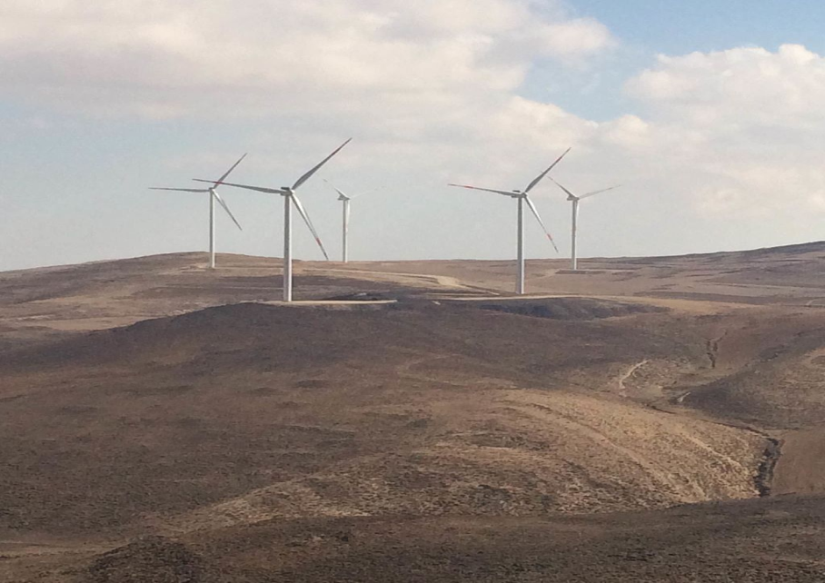
Arab World – Transaction Highlights (1)
Supported by an OFID loan of US$ 20 Mn, Jordan built the 117MW Tafila Wind Farm in 2013 at a total project cost of US$ 287 Mn.
It was the country’s first renewable energy project and first private wind energy project to reach financial close in the MENA region outside of Morocco.
The Tafila Wind Farm was developed by Jordan Wind Project company, a co-development partnership between InfraMed (Regional Investment vehicle), Masdar (renewable energy arm of Mubadala), EP Global Energy Ltd (Cyprus)
At completion, the Tafila Wind Farm’s generated electricity accounts for 6.5% of Jordan’s renewable energy target of 1,800 MW by 2020, generating an estimated annual 400 gigawatt hours. It creates enough electricity to power 83,000 homes.
During construction, the project created 250 jobs. Now in operation, it employs around 40 personnel, adding value to local Jordanian communities.
9

Slide 10
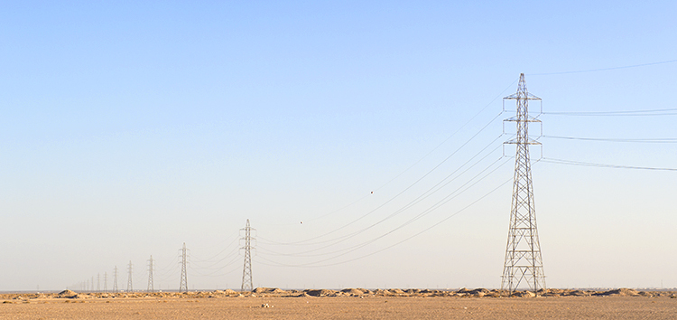
Arab World – Transaction Highlights (2)
OFID provided US$ 40 Mn for the construction of a 485 MW combined-cycle gas turbine thermal power station in Jordan
The total investment amount of the project is approximately $490 Mn, and it is expected to employ 1,500 workers during peak construction. The natural gas-fired project is expected to generate an average of 3.2Twh of electricity a year, which is the consumption equivalent of approximately 620,000 individual residential customers.
The sponsor of the project is majority owned by ACWA Power International, a leading power and desalinated water provider, owned primarily by Saudi and international shareholders
For Jordan, encouraging the development of cost-efficient power projects is paramount, given that power subsidies are a significant driver of its budget deficit. The new plant will improve Jordan’s energy efficiency, increase the required base load power in the country and support the government’s goal of meeting rapid electricity demand growth
10

Slide 11
Arab World – Transaction Highlights (3)
Zain (then known as Mobitel) was a joint venture between the Sudanese Telephone Company Ltd and several private shareholders until 2006, when it was fully acquired by the Zain Group (Kuwait).
OFID, in 2007, was part of a consortium of Arab lenders including Boubyan Bank, Gulf Bank, Arab Bank, National bank of Kuwait, Bank Audi and Byblos Bank to provide a EUR 270 Mn debt package to support the capital expenditure and working capital needs of Zain
Zain in Sudan is the pioneer of GSM services in Sudan, being the first to offer mobile operations back in February 1997. Today it serves the largest base of mobile customers in the country with more than 12 million active customers.
11

Slide 12
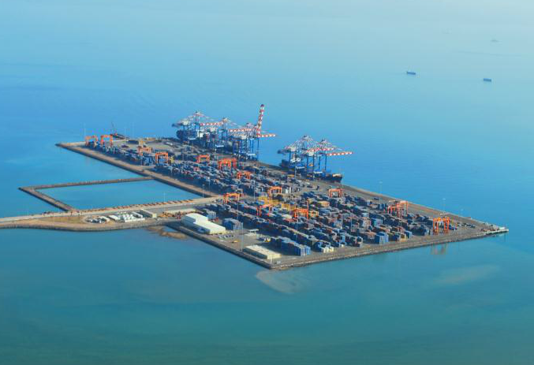
Arab World – Transaction Highlights (4)
OFID provided US$ 15 Mn debt financing (Islamic finance compliant) as part of a debt package of US$ 400 Mn for the construction of the new Doraleh Container Terminal in the Republic of Djibouti in 2009.
Joint Venture between Dubai Ports World and the Djiboutian Government who signed a 40 year concession agreement to operate the Terminal.
It was the first ever PPP style financing in the country and the new terminal has helped to improve the efficiency of the port and relieve vital capacity constraints while also generating local employment and revenue.
Djibouti can now handle more than twice as much container traffic as before (1.6 Mn TEU of handling capacity), is able to host the latest generation of giant container ships (including super post panamax) and is in a position to establish itself as a gateway to the market for Eastern and Southern Africa. This will strengthen Djibouti's economy and foster regional integration through the development of trade
12

Slide 13
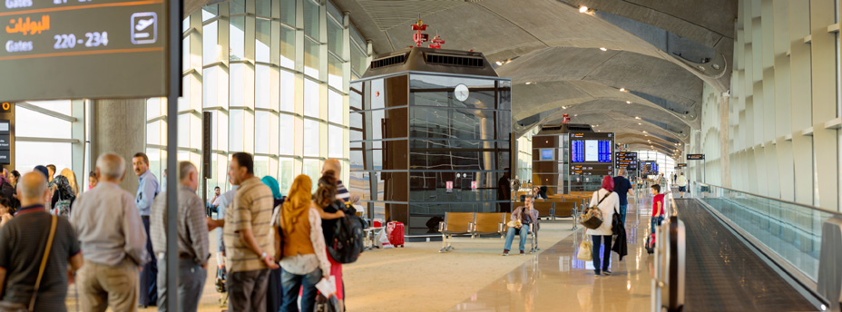
Arab World – Transaction Highlights (5)
OFID provided US$ 15 Mn in Islamic financing to facilitate the upgrade of Jordan’s Queen Alia Airport in 2007, which cost a total of US$ 700 Mn
It was a landmark transaction, as the first airport PPP project in the Middle East and was also done in record time: financial close was reached just six months after the bid award.
The consortium members who were awarded the concession agreement include Aeroports de Paris Management (France), the Abu Dhabi Investment Company (UAE), Noor financial Investment Company (Kuwait), J&P- Avax (Greece) and Joannou & Paraskevaides (Cyprus).
Awarded best airport in the Middle East by Airport Council International for three consecutive years (2014,2015 and 2016).
The successful completion of the Airport—Jordan’s largest private sector investment project to date—demonstrates the value of private sector capital in infrastructure financing, the complexity of implementation, and the role that multilateral development banks like OFID play.
13

Slide 14
Arab World – Transaction Highlights (6)
OFID has provided debt financing and equity investments totalling US$ 13 Mn in Banque Populaire De Mauritanie (formerly known as Mauritania Leasing).
OFID thus participated in successfully establishing the first leasing company in Mauritania, which has played a major role in funding SMEs
OFID’s investments have also helped the company transform from a leasing institution to a universal bank with a market share of more than 23% of all medium and long term financial assistance in Mauritania
14

Slide 15
Arab World – Transaction Highlights (7)
OFID has supported Byblos Bank (Lebanon) in its international expansion across three continents, via the provision of equity and debt investments
Byblos, the second largest bank in Lebanon by total assets, was thus able to further expand its strategic international presence and provide increased access to finance even in difficult environments
OFID supported Byblos’ investments in Syria, Sudan and Armenia, markets where raising equity funding from traditional investors was challenging and also in its home market of Lebanon
15

Slide 16
PSTFOD Operations in the Arab World (1) – since Private Sector inception in 1998, OFID has financed 68 projects totalling US$ 1.268 Bn representing >20% of cumulative approvals
No. | Country | Project | Sector | Approved Amount ($)
1 | Bahrain | United Stainless Steel Company (USCO) | INDUSTRY | $ 10,000,000.00
2 | Bahrain | United Stainless Steel (USCO), Permanent Working Capital Facility | INDUSTRY | $ 5,555,555.56
3 | Bahrain | Bahrain Steel BSCC E.C. | INDUSTRY | $ 15,000,000.00
4 | Djibouti | Doraleh Container Terminal (DCT) | TRANSPORT AND STORAGE | $ 15,000,000.00
5 | Djibouti | ITFC Scheme - The Republic of Djibouti (RD) | INDUSTRY | $ 8,000,000.00
6 | Egypt | Egyptian Fertilizers Company | INDUSTRY | $ 5,000,000.00
7 | Egypt | Maridive and Oil Services S.A.E | ENERGY GENERATION, DISTRIBUTION AND EFFICIENCY | $ 5,000,000.00
8 | Egypt | Glass Container Company (GCC) | INDUSTRY | $ 4,410,000.00
9 | Egypt | Egyptian Housing Financial Company Equity | BANKING AND FINANCIAL SERVICES | $ 1,700,000.00
10 | Egypt | Mudaraba Financing (EGPC - Facility I) | MINERAL RESOURCES AND MINING | $ 25,000,000.00
11 | Egypt | EGPC - Facility II | MINERAL RESOURCES AND MINING | $ 25,000,000.00
12 | Egypt | Petroleum Export V Limited (PEL IV) | MINERAL RESOURCES AND MINING | $ 50,000,000.00
13 | Egypt | Petroleum Export V Limited (PEL V) | MINERAL RESOURCES AND MINING | $ 50,000,000.00
14 | Egypt | ITFC Scheme - Ministry of Petroleum and Mineral Resources, Egypt | MINERAL RESOURCES AND MINING | $ 50,000,000.00
15 | Egypt | ITFC Scheme - Government of Egypt (GoE) | MINERAL RESOURCES AND MINING | $ 50,000,000.00
16 | Egypt | ITFC Scheme - Arab Republic of Egypt (ARE) | MINERAL RESOURCES AND MINING | $ 50,000,000.00
17 | Egypt | ITFC Scheme - Arab Republic of Egypt (ARE) | MINERAL RESOURCES AND MINING | $ 50,000,000.00
18 | Egypt | ITFC Scheme - Arab Republic of Egypt (ARE) | INDUSTRY | $ 47,000,000.00
19 | Jordan | Airport International Group (AIG) | TRANSPORT AND STORAGE | $ 15,000,000.00
20 | Jordan | Qatrana Electric Power Company (QEPC) | ENERGY GENERATION, DISTRIBUTION AND EFFICIENCY | $ 20,000,000.00
21 | Jordan | Jordan Wind Project Company (JWPC) | ENERGY GENERATION, DISTRIBUTION AND EFFICIENCY | $ 20,000,000.00
22 | Jordan | Falcon Ma'an Solar Power (FMSP) | ENERGY GENERATION, DISTRIBUTION AND EFFICIENCY | $ 10,000,000.00
23 | Jordan | Jordan Solar One (JSO) | ENERGY GENERATION, DISTRIBUTION AND EFFICIENCY | $ 15,000,000.00
24 | Jordan | Mahatet Al Zarqa Le Tawleed Al Takah Al Kahrabaieyah | ENERGY GENERATION, DISTRIBUTION AND EFFICIENCY | $ 40,000,000.00
25 | Jordan | ITFC Scheme - The Government of Jordan | MINERAL RESOURCES AND MINING | $ 50,000,000.00
26 | Jordan | ITFC Scheme - Government of Jordan (GoJ) | MINERAL RESOURCES AND MINING | $ 50,000,000.00
16

Slide 17
OFID Uniting Against Poverty
PSTFOD Operations in the Arab World (2)
No. | Country | Project | Sector | Approved Amount ($)
27 | Lebanon | Byblos Bank | BANKING AND FINANCIAL SERVICES | $ 5,000,000.00
28 | Lebanon | Byblos Ventures (Investment Fund) | BANKING AND FINANCIAL SERVICES | $ 5,000,000.00
29 | Lebanon | Banque Libano Francaise (BLF) | BANKING AND FINANCIAL SERVICES | $ 20,000,000.00
30 | Lebanon | Lebanon and Gulf Bank
30 | Mauritania | Mauritanie Leasing (ML) | MULTISECTOR/CROSS-CUTTING | $ 2,500,000.00
31 | Mauritania | Mauritanie Leasing II | BANKING AND FINANCIAL SERVICES | $ 5,000,000.00
32 | Mauritania | Societe d'Elaboration des Produits Halieutiques S.A. (SEPH) | FISHING | $ 4,000,000.00
33 | Mauritania | Societe Nationale Industrielle et Miniere (SNIM) | MINERAL RESOURCES AND MINING | $ 15,000,000.00
34 | Mauritania | Banque Populaire de Mauritanie (BPM) | BANKING AND FINANCIAL SERVICES | $ 5,000,000.00
35 | Mauritania | Mauritanie Leasing (ML) | BANKING AND FINANCIAL SERVICES | $ 500,000.00
36 | Mauritania | Revolving Loan for Financing of Food Imports by SONIMEX | MULTISECTOR/CROSS-CUTTING | $ 5,000,000.00
37 | Mauritania | B.B. Energy (Gulf) DMCC - Dubai Tax-free Zone | MINERAL RESOURCES AND MINING | $ 9,125,000.00
38 | Mauritania | B.B. Energy (Gulf) DMCC - Dubai Tax-free Zone | MINERAL RESOURCES AND MINING | $ 10,875,000.00
39 | Mauritania | ITFC Scheme - Government of Mauritania (GoM) | MINERAL RESOURCES AND MINING | $ 20,000,000.00
40 | Morocco | Murabaha Financing to SAMIR (Facility I) | MINERAL RESOURCES AND MINING | $ 25,000,000.00
41 | Morocco | SAMIR (Facility II) | MINERAL RESOURCES AND MINING | $ 25,000,000.00
42 | Morocco | ITFC Scheme - Univers Acier (UA) | INDUSTRY | $ 10,000,000.00
43 | Morocco | ITFC Scheme - Dimagaz SA (Dimagaz) | MINERAL RESOURCES AND MINING | $ 20,000,000.00
44 | Morocco | ITFC Scheme - Societe Anonyme Marocaine de l'Industrie et du Raffinage (SAMIR) | MINERAL RESOURCES AND MINING | $ 47,000,000.00
45 | Morocco | ITFC Scheme - OCP S.A. (OCP) | MINERAL RESOURCES AND MINING | $ 24,000,000.00
46 | Morocco | ITFC Scheme - OCP S.A. (OCP) | MINERAL RESOURCES AND MINING | $ 24,000,000.00
47 | Sudan | Kenana Sugar | AGRICULTURE | $ 10,000,000.00
48 | Sudan | SUDATEL | COMMUNICATIONS | $ 7,600,000.00
49 | Sudan | Sudanese Mobile Telephone Company (MOBITEL) | COMMUNICATIONS | $ 11,429,485.79
50 | Sudan | Byblos Bank Africa (BBA) | BANKING AND FINANCIAL SERVICES | $ 5,000,000.00
17

Slide 18
PSTFOD Operations in the Arab World (3)
No. | Country | Project | Sector | Approved Amount ($)
51 | Sudan | Byblos Bank Africa (BBA) | BANKING AND FINANCIAL SERVICES | $ 5,000,000.00
52 | Sudan | The Arab Leasing & Investment Co. (TALICO) | BANKING AND FINANCIAL SERVICES | $ 3,000,000.00
53 | Sudan | Kenana Sugar Company Limited | INDUSTRY | $ 25,000,000.00
54 | Sudan | Byblos Bank Africa | BANKING AND FINANCIAL SERVICES | $ 5,000,000.00
55 | Syria | Clay Industries Company S. A. | INDUSTRY | $ 4,000,000.00
56 | Syria | Byblos Bank Syria (BBS) | BANKING AND FINANCIAL SERVICES | $ 3,000,000.00
57 | Syria | Byblos Bank Syria (BBS) | BANKING AND FINANCIAL SERVICES | $ 6,600,000.00
58 | Tunisia | Tunisie Leasing | BANKING AND FINANCIAL SERVICES | $ 4,571,794.31
59 | Tunisia | Orascom Telecom Tunisie S.A. | COMMUNICATIONS | $ 11,429,485.79
60 | Tunisia | TAV Tunisie (Enfidha and Monastir Airport Projects) | TRANSPORT AND STORAGE | $ 22,184,376.91
61 | Tunisia | Tunisian Indian Fertilizer S.A. (TIFERT) | INDUSTRY | $ 30,000,000.00
62 | Tunisia | ITFC Scheme - The Government of Tunisia (GoT) | MINERAL RESOURCES AND MINING | $ 25,000,000.00
63 | Tunisia | ITFC Scheme - Société Tunisienne des Industries de Raffinage (STIR) | MINERAL RESOURCES AND MINING | $ 25,000,000.00
64 | Tunisia | ITFC Scheme - The Tunisian Company of Electricity and Gas (STEG) | MINERAL RESOURCES AND MINING | $ 25,000,000.00
65 | Tunisia | ITFC Scheme - The Tunisian Company of Electricity and Gas (STEG) | MINERAL RESOURCES AND MINING | $ 25,000,000.00
66 | Tunisia | ITFC Scheme - Société Tunisienne des Industries de Raffinage (STIR) | MINERAL RESOURCES AND MINING | $ 25,000,000.00
67 | Yemen | Radfan for Manufacturing Ceramics and Porcelain Company (RMCPC) | INDUSTRY | $ 5,000,000.00
68 | Yemen | Mukalla Iron & Steel Company (MISC) | INDUSTRY | $ 16,000,000.00
Total |  |  |  | $ 1,268,480,698.36
18

Slide 19
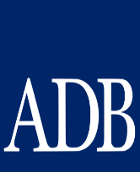
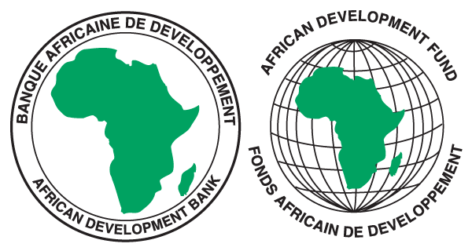
PS & TF Strategic Partners
Multilateral DFIs
Bilateral
DFIs
Commercial Banks
REGIONAL
DEVELOPMENT
BANKS
19

Slide 20
Advantages of working with OFID
Experienced - with nearly 40 years experience of helping alleviate poverty.
Developmental - operations are across a diverse range of sectors and assist OFID fulfil its mandate and supporting the Sustainable Development Goals. Energy sector investments are linked to SDG 7 (Affordable and Clean Energy) while investments in Financial Institutions and support of SMEs are linked to SDG 8 (Decent work and Economic Growth).
Global reach – ability to operate in 134 low and middle income countries, with a preferred creditor status in more than 65 countries.
Responsive – understands project requirements, provides a wide product range and flexible with regard to project/country priorities.
Long-term partnerships - able to adopt a long-term approach and to cope with country and sector risks.
Cooperation - with a global network of multilateral & bilateral institutions.
20

Slide 21
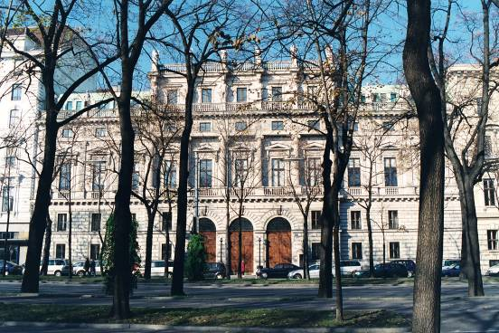
Contact Details
Acting Assistant Director General, Private Sector and Trade Finance
Operations Department
OFID
Parkring 8
A- 1010 Vienna -Austria
Telephone: +431 515 64 0
Fax: +431 513 92 38
For further details visit our Website:
www.ofid.org
or Email: PSTFOD@ofid.org
21

