Slide 1
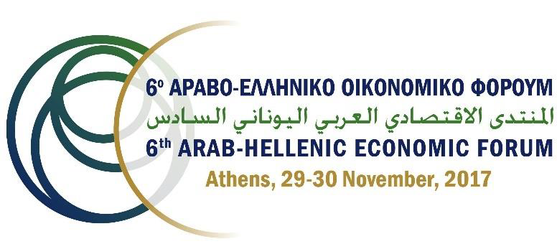

Slide 2
Facts about IRAQ
Area : 437072 sq KM
Population: approximately 38 146 025 @2016
Political system: Parliamentary / PM / government
Exchange rate : 1 US$ = 1180 ID Central Bank, =1250ID local market
Economy : open , dependant on Oil. 86%form revenue
Export : 99.5% export oil,
import 326BUS$ in 8 years
GDP: 192billion US$
Debit: 106 billion US$ (42$B Ext, 64$B Int)
Transportation : 1 Port , 6 Airport, Road network ,
limited railway network
Location : E /Iran , S/ Kuwait & KSA
N/Turkey, W/ Jordan /Syria

Slide 3
OIL
Production 4.5mbpd,
export 3.75mbpd
6 % of today’s global oil exports
9 % of total global reserves
Fifth largest proven reserves of petroleum
The cost of oil production in Iraq is one of the lowest in the
58 percent of the country’s GDP

Slide 4
Oil geography

Slide 5
Iraqi Public Income

Slide 6
الإيرادات والنفقات التقديرية للسنوات (2017-2021) وفقاً للمعطيات الحالية (ترليون دينار)
Iraqi Budget
2021 | 2020 | 2019 | 2018 | 2017
3.4 | 3.4 | 3.4 | 3.4 | 3.2 | Exported oil (mbpd)
52.8 | 52.2 | 51.9 | 52.4 | 52.3 | Oil price $pb Brent
45.8 | 45.2 | 44.9 | 45.9 | 45.3 | Oil price $pb Iraq
69.0 | 67.7 | 65.9 | 65.0 | 61.5 | Total Oil income ( T ID)
(14.6) | (14.5) | (14.3) | (14.2) | (13.7) | Paid for IOCs and field invest.
54.4 | 53.2 | 51.6 | 50.8 | 47.8 | Net Oil income ( T ID)
13.4 | 12.0 | 10.8 | 9.9 | 8.1 | Non Oil Income ( T ID)
67.8 | 65.2 | 62.4 | 60.7 | 55.9 | Total overall income
(45.8) | (46.5) | (47.0) | (46.7) | (46.5) | Committed payment Salaries, pension , subsidies etc
22.0 | 18.70 | 15.4 | 14.0 | 9.40 | Budget

Slide 7
Economy
The central government alone has expanded to 44 percent of GDP today
The public sector is by far the largest formal sector employer.
SOEs was strengthened as the state had no incentives to restructure them. !! Need to
Tension between the need to improve the basic services and the overwhelming role that the state plays in the economy
A sharp decline in the share of both exports and imports as a percentage of GDP lies behind this trend.

Slide 8
الدين العام
IMF
External
Total

Slide 9
Government Program
Liberate all areas from ISIS
Fight corruption
Diverse the Economy
Encourage Public Private Partnership
Local and public election May 2017
Reconstruct liberated areas
Reduce public expenditure

Slide 10
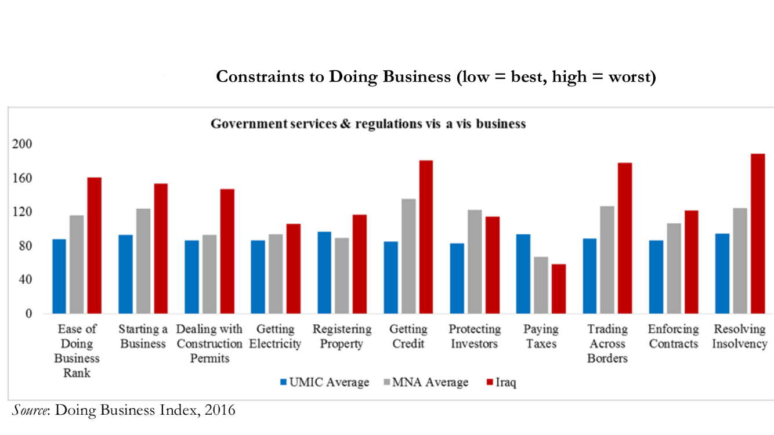
DOING Business in Iraq

Slide 11
Why doing Business in Iraq
Potential for future
Strategic Location
Demandable Market
Mineral and Natural resources
Availability of human resources
Sufficient local partners
High profit hub

Slide 12
Strategic opportunities
Establishment of new Petrochemical plant
Rehabilitation and up grading of the existing petrochemical plant
Establishment of new Fertilizer plant /production line
Investing in Mining
Partner ship with any of SOEs
Partnership with private sector
5trillion of Iraqi Dinars to be injected to the industry by central bank

Slide 13
SOE”s
Type | Main productions | No. SOE | No of Factories
Heavy industry | Steel, cars, machineries | 5 | 20
Electronic | Telecom., hardware, cameras ,….. | 2 | 12
Electrical | Transformers, cables , generators……. | 4 | 25
Mechanical | Water treatment, hydraulics, copper | 3 | 15
Civil and construction | Cement, construction material ,pipes, class, tiles | 4 | 47
chemical | Chlorine, pesticide, rubber… | 4 | 23
Petrochemical | Polyethylene ,paper, | 1 | 10
Fertilizers | Ammonia, urea, | 1 | 7
Phosphate | Sulfuric acid phosphoric acid,,….. | 1 | 9
Food industry | Dairy , oil, sugar…. | 1 | 14
Medical equipments and drugs | All medicines and medical equipments | 1 | 5
Textile and tanning | Shoes, clothes , blankets, cotton, carpet | 1 | 37
Military | ________ | 1 | 8
Sulfur | All sulfur kinds and alum | 1 | 4
 |  | 30 | 236

Slide 14
Legal Framework
Partnership with SOE : Law 22 /1997
Partnership with P S : Law 21 / 1997
Public Private Partnership /Cabinet resolution 492
Investment Law 13 / 2006
Mining Investment Law 91/ 1989

Slide 15
Conclusion
Iraq is a potential business opportunities
Privatization is the solution for the Future of Iraq Economy
The Private sector in Iraq is your potential partner
Banking is one of the most important business in Iraq
Credit rating, WB loans, IMF support, and some European countries Guaranties are giving signs for future
Iraq comply with OECD regulations

Slide 16
THANK YOU
Q
A
&

