Slide 1
Presentation by Alexandros Chatzieleftheriou

Slide 2
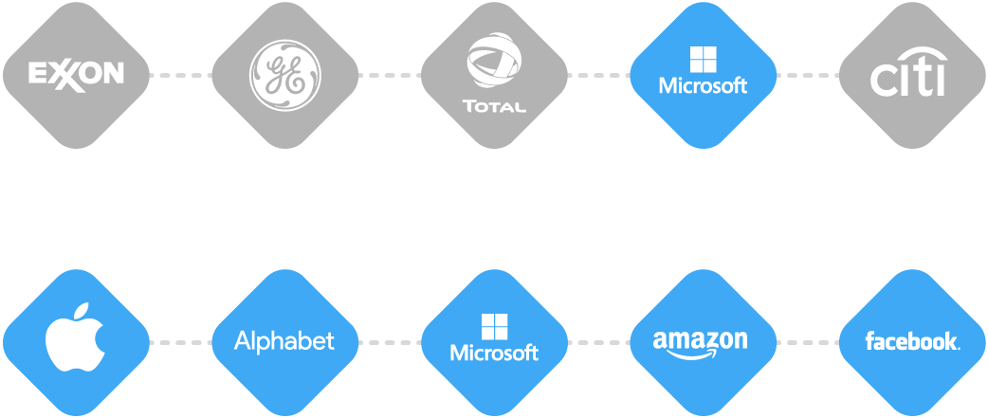
Top 5 Publicly Traded Companies (by Market Cap)
TECH
OTHER
2006
$446B
$383B
$327B
$293B
$273B
2017
$889B
$719B
$646B
$549B
$529B

Slide 3
Unicorns by country, 2017*
United States
107
70
China
54
Silicon valley
India
10
United Kingdom
9
Germany
4
South Korea
3
*Source: CB Insights

Slide 5
“The exciting thing is, all you need are the people. If you could attract a critical mass of nerds and investors to live somewhere, you could reproduce Silicon Valley.”
Paul Graham, Y combinator founder

Slide 6
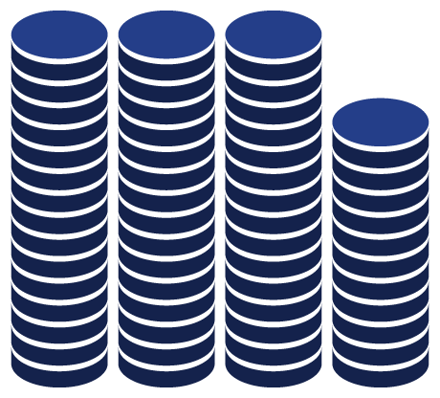
Angel investment stats
Angel investments in US 2015:
Angel investments in Greece 2015:
US$ 25B
US$ 5M
Angel investment / GDP:
Angel investment / GDP:
1.4‰
0.025 ‰
US angel investing is 54x compared to Greece in GDP analogous terms

Slide 7
Key angel investor figures
Recommended net worth:
% of assets invest:
Startup success rate:
10%
10%
(or 200K)
¤ 2M
(excluding primary residence)
Investment time horizon:
¤ 25-150k
per placement
5-10 years

Slide 8
“I invest because I love helping entrepreneurs and watching them learn and succeed and not ego satisfaction or “making a buck”
Ron Conway, considered one of the best Angel investors, with investments, among others, in Google, PayPal

