Slide 1

“New Opportunities for Greece’s Energy Trade with the Arab World”
6th Arab-Hellenic Economic Forum 2017
Athens, November 29-30, 2017
A Presentation by Costis Stambolis,
BSc, A.A. Dip. Grad., Dip. SI (Oxford), MIE,
Executive Director
Institute of Energy for S.E. Europe (IENE), Athens
INSTITUTE OF ENERGY
FOR SOUTH EAST EUROPE

Slide 2
Investment Opportunities in Greece’s Energy Sector
As Greece is slowly coming out from the worst recession in its history, the energy sector is expected to play a key role in supporting a return to economic growth.
Apart from providing much needed infrastructure for the use of different forms of energy (i.e. oil, gas, RES, electricity, energy efficiency and CHP), the energy sector can attract much needed investment for new projects, but also for marketing activities following electricity and gas market deregulation and rising competition.
The ongoing privatization programme of major state controlled enterprises in electricity and gas is attracting investor interest if we are to judge from the sale of 24% stake of the Electricity Grid Operator (ADMIE) to China’s State Grid for €320 million.
Furthermore, Greece is pursuing efforts to exploit its considerable hydrocarbon resources.

Slide 3
Some Key Energy Facts in Greece
The Greek energy sector now corresponds to approx. 6% of GDP, compared to tourism’s contribution of 18.5% to the country’s GDP in 2016.
In Greece’s energy sector, approx. 150,000 people are employed directly and indirectly: in oil refining, oil marketing and bunkering, electricity production and distribution, electrical equipment manufacturing, natural gas marketing and installation, RES, etc.
An oil-dominated energy sector with 313 thousand barrels per day primary oil consumption in 2016 (444 thousand in 2006).
Indigenous oil production stands at approx. 5,000 barrels per day in H1 2017.
Greece imports almost all its crude oil with Arab countries playing a major role.

Slide 4
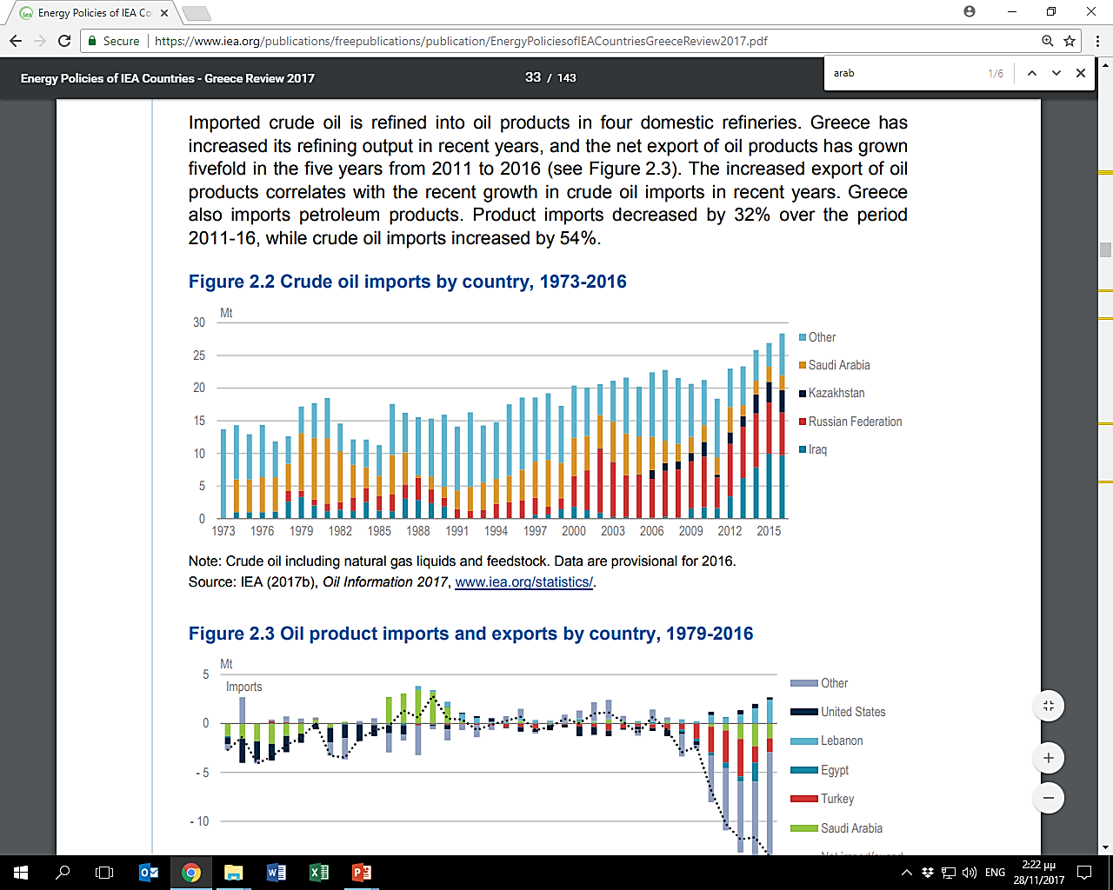
Crude Oil Imports by Country, 1973-2016
Source: Energy Policies of IEA Countries – Greece, 2017

Slide 5
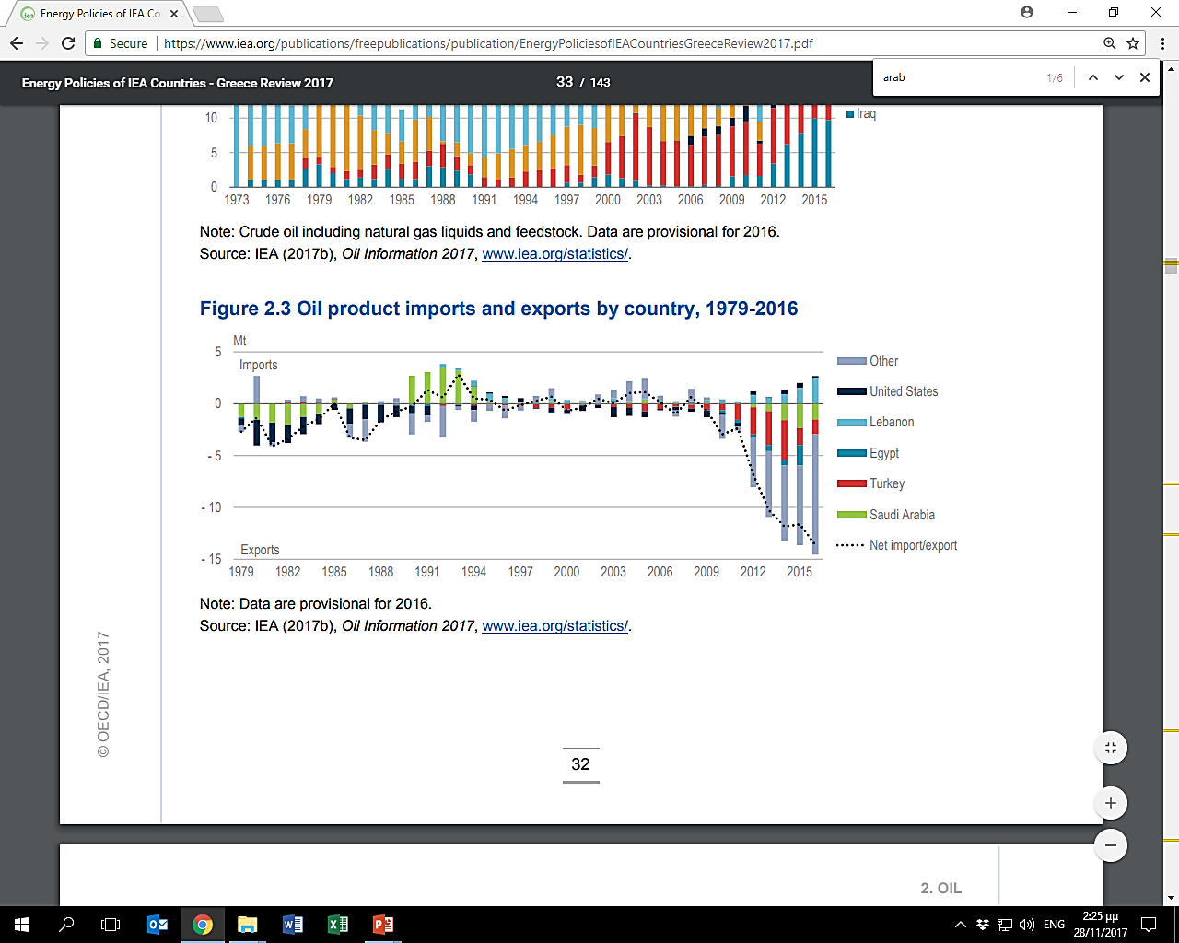
Oil Product Imports and Exports by Country, 1979-2016
Source: Energy Policies of IEA Countries – Greece, 2017

Slide 6
Greek Oil Market Fundamentals (2010-2016)
 | 2010 | 2011 | 2012 | 2013 | 2014 | 2015 | 2016
Net oil imports-crude and products (in bill. €) | -8.60 | -11.13 | -10.22 | -6.91 | -6.27 | -4.21 | -2.83
Refined oil product exports (in bill. €) | 4.90 | 6.19 | 7.43 | 9.49 | 9.05 | 6.71 | 6.16
Total Oil imports (crude and products) (in bill. €) | 13.50 | 17.31 | 17.65 | 16.4 | 15.32 | 10.92 | 8.99
Sources: Bank of Greece, ELSTAT

Slide 7
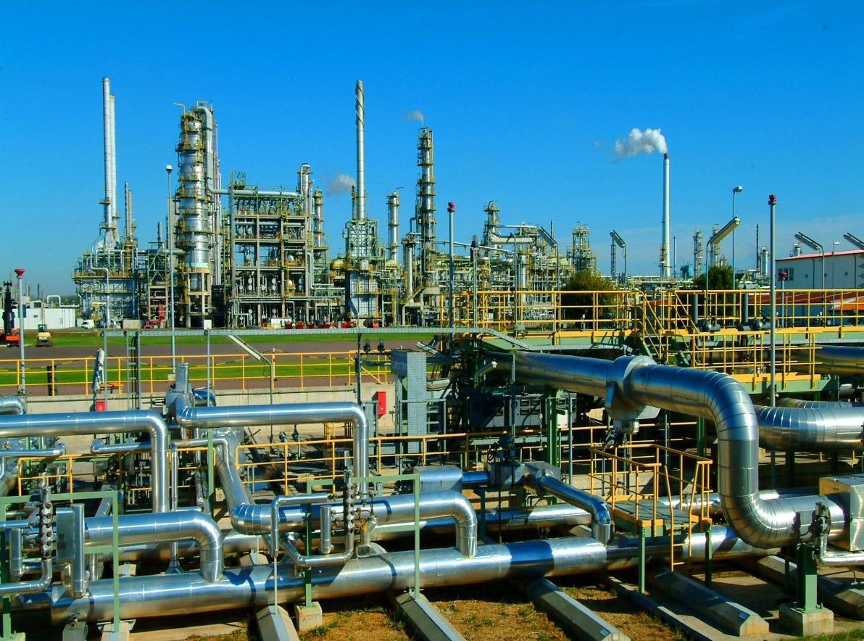
Oil Refining and Storage
A total of €4.0 billion of investments in refinery upgrade and expansion were implemented between 2010 and 2014
A further €1.0 billion to be invested in downstream activities by 2025
Greece imports some 14.5 mt/y for refining, destined for local consumption and exports, of which approximately 60% comes from Arab countries

Slide 8
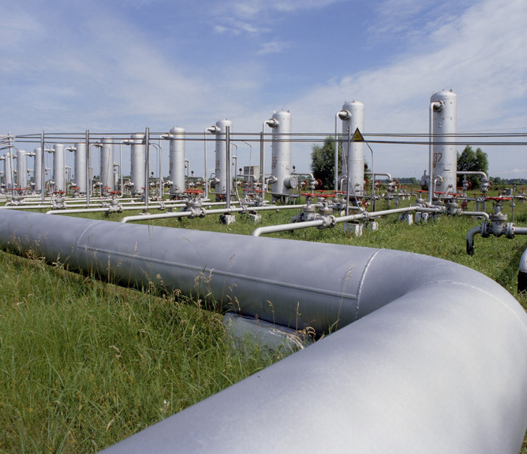
Natural Gas
Current consumption ~ 4.0 bcm per year (2017) and likely to rise to 6.0 bcm per year by 2025
Investments necessary for new LNG terminal(s), trunk pipelines, international interconnections and additional town distribution grids
Since early 2000’s, LNG is exported to Greece from Algeria, but lately it also imports LNG from Qatar. At current prices, this overall trade, accounts to approximately $6.5-7.0 billion per year.

Slide 9
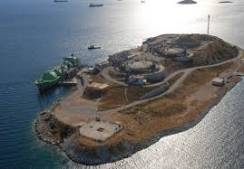
Revithoussa LNG Terminal

Slide 10
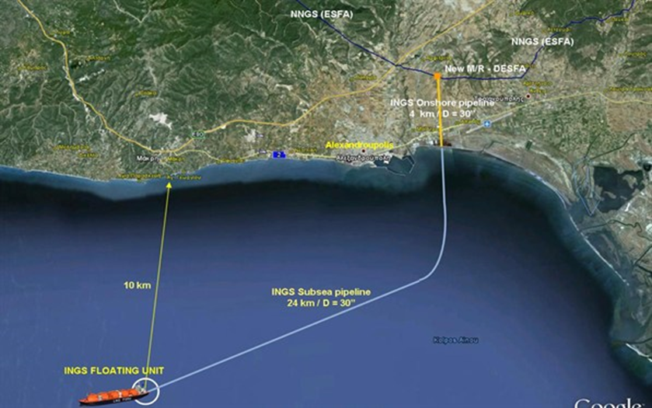
Alexandroupolis FSRU (I)

Slide 11
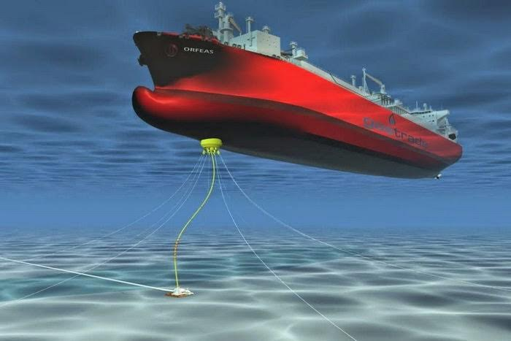
Alexandroupolis FSRU (II)

Slide 12
TAP and TANAP system

Slide 13
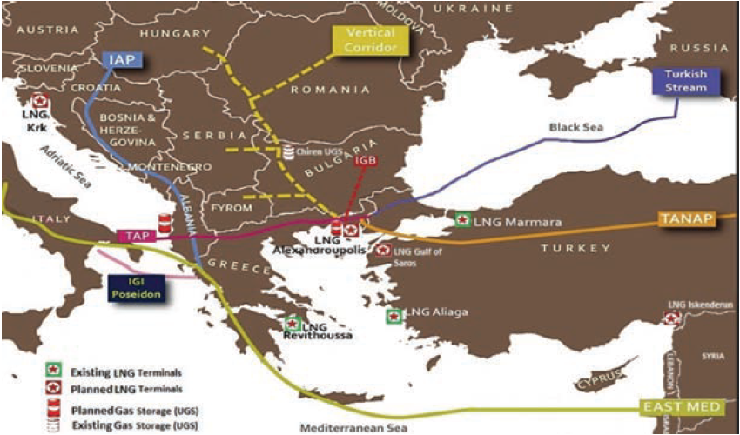
An Expanded Southern Gas Corridor
NB.: The TANAP and TAP gas pipelines as well as Turkish Stream are under construction, with IGB at an advanced planning stage with FID already taken. The IAP, the IGI Poseidon in connection with East Med pipeline and the Vertical Corridor are still in the study phase.

Slide 14
Greek Export Activities
On the export side, Greek companies are becoming increasingly active in the export of oil products to a small group of countries in the region (i.e. Lebanon, Egypt, Libya) and the provision of integrated engineering services, as EPC contractors, for the construction of major power generation plants with latest projects in Iraq, Syria and Libya.
  These are natural gas fired combined cycle plants in the range of 300-500MW of installed capacity each but lately also involve photovoltaic parks, stand alone or grid connected.
The development of main electricity interconnection projects between North Africa and Europe, via Greece, is also under consideration.

Slide 15
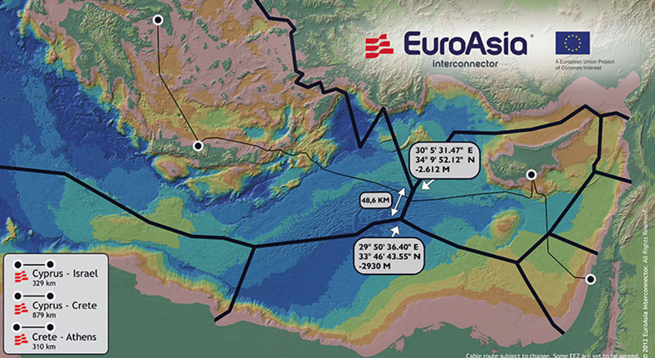
EuroAsia Electricity Interconnector

Slide 16


Slide 17
Summary of Anticipated Energy Sector
Investment in Greece (2016-2025) (Base Scenario)
 | Million Euros
Hydrocarbons
Upstream | 3,000
Downstream | 1,400
Natural Gas
Trunk Pipeline and Grid Expansion | 1,900
LNG (including Alexandroupolis FSRU and Revithoussa expansion) and UGS | 1,100
Electricity
Power generation (thermal plants and large hydro) | 3,700
Electricity Grid and island interconnections | 3,400
Renewable Energy Sources
PV (including electricity storage system) | 2,000
Concentrating Solar Power (CSP) | 200
Wind | 5,500
Small hydro | 100
Biomass (including liquid biofuels) | 700
Geothermal | 300
Total | 23,300

Slide 18
Investment Opportunities in Greece’s Energy Sector
According to recently published IENE’s “SEEEO 2016/2017”, a total of more than €23 billion of energy infrastructure projects are to be implemented in Greece over 2016-2025. These projects will cover:
  the expansion and upgrading of the country’s electricity grid focusing on much needed island-mainland interconnections,
  the expansion of the gas transmission and distribution grid,
  the construction of crucial gas interconnectors for electricity and LNG facilities,
  the addition of new thermal power generation units and several renewable energy installations for electricity and heat generation (i.e. solar PV and solar thermal, wind farms, biomass, small hydro and geothermal).
Further to the above energy related infrastructure business and investment opportunities are to be found in Greece’s fast changing electricity sector. Thanks to EU’s unbundling and liberalization policies this sector it now becoming more competitive with opportunities for new entrants.
There are also considerable opportunities in the fast growing energy efficiency business area.

Slide 19
Investment Opportunities in Greece’s Energy Sector
Today, there are opportunities in the offing for Arab companies to invest in Greece’s expanding energy market.
These involve energy infrastructure projects ranging from city and industrial gas networks, major regional gas pipeline projects and interconnectors, power generation plants, based on both conventional and renewable energy sources, energy trade and retail activities, energy efficiency schemes and cogeneration.
With Greece, because of its location and advanced market structure, having gained a strategic role for energy markets in the whole of SE Europe.
Hence, potential Arab investments in Greece’s energy sector have a much bigger scope as the country acts as a convenient entry point to the region’s buoyant energy markets.

Slide 20

Thank you for
your attention
www.iene.eu
cstambolis@iene.gr

