Slide 1
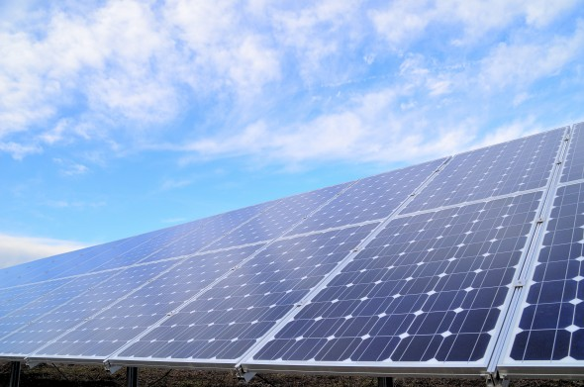
National industrial and agricultural projects for Egyptian sustainable development
Gen. Dr. Eng. Mustafa Hadhoud
Chairman and Managing director of the Egyptian company for agriculture and rural development
Arab Greek Forum
Athens
From 29-30 November 2017

Slide 2
National projects for Egyptian sustainable development
National Project of
Solar energy
National Petrochemical Project
National project For contractual crops

Slide 3
National industrial and agricultural projects for Egyptian sustainable development
National Project of Solar Energy
Gen. Dr. Eng. Mustafa Hadhoud
Chairman and Managing director of the Egyptian company for agriculture and rural development
Arab Greek Forum
Athens
From 29-30 November 2017

Slide 4
The Aim of this study is to introduce key lights on:
- The future of energy in Egypt,
- PV solar Market
- PV solar Technologies
PV solar role in fulfilling Egypt’s
requirements up to 2022 and up to 2030

Slide 5
Existing and Forecasted Electrical Power Resources in Egypt
Up to 2030

Slide 6
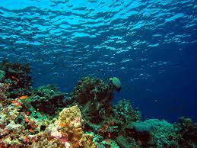
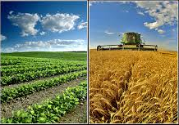
Egypt looks for higher developments rate in the industry, agriculture sectors and sea water desalination to overcome the lack and shortage of water as a whole.

Slide 7
Egypt is different from other countries in Europe as a whole and many Arabic and Middle East countries in the higher annual rate of population increase which reached about 2.55 %. During 2016
The expected increase of Egyptian population up to 2030 is about 38 millions to reach 128 millions total population in that year.

Slide 8
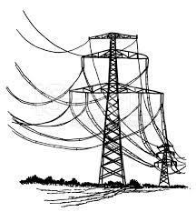
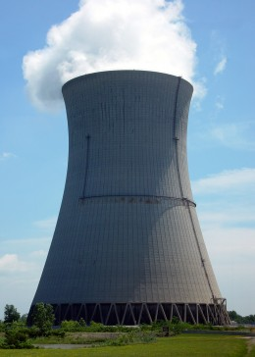
Egypt requires at least 3500 up to 4000 MW electricity annual new production up to 2030 to fulfill requirements of new populations, new industries, new towns and villages ,water desalination stations, agriculture requirements …. etc.
The share of new and renewable and nuclear sources of energies must have a higher share for this new requirements by at least 30% that’s about 25000 MW (25 GW) during 2030

Slide 9
Renewable
Energy
Wind Energy
Photovoltaic
Solar Energy
Biomass / Biogas
Geothermal
Energy
Pumped-storage hydroelectricity

Slide 10
Current and future distribution of electrical generation sources in Egypt until 2030
Source of Electrical energy | 2016 |  | 2020 |  | 2022 |  | 2030
 | Quant. | Presen. | Quant. | Presen. | Quant . | Presen. | Quant. | Presen.
Thermal energy compounded by gas | 27.80 | 88 | 45.0 | 80.36 | 47.0 | 72.20 | 47.80 | 56.23
High dam | 2.80 | 8.86 | 2.8 | 5.00 | 2.80 | 4.30 | 2.80 | 3.29
Wind Energy | 0.75 | 2.37 | 3.0 | 5.60 | 4.00 | 6.14 | 6.00 | 7.05
Solar Energy | 0.20 | 0.63 | 5.0 | 8.83 | 6.00 | 9.22 | 11.0 | 12.94
Biogas and Biomas | 0.05 | 0.16 | 0.2 | 0.35 | 0.50 | 0.77 | 0.60 | 0.71
Nuclear Energy | 0.00 | 0.00 | 0.00 | 0.00 | 0.00 | 0.00 | 4.80 | 5.64
Thermal coal | 0.00 | 0.00 | 0.00 | 0.00 | 4.80 | 7.37 | 12.00 | 14.11
Total | 31.6 | 100 | 56.0 | 100 | 70.4 | 100 | 85.0 | 100

Slide 11
Investment costs for build up a generating station 1000 MW annually Without annual operating expenses |  | Energy generation technology
Billion Egyptian Pound | Billion Dollar
75 | 4.17 | Nuclear Energy
30 | 1.63 | Solar Energy
21 | 1.15 | Thermal energy
31 | 1.70 | Wind Energy

Slide 12
The role of solar energy in supporting the implementation of the Egyptian plan to increase the capacity of electricity generation until 2030
Egypt plans to increase the electricity produced in Egypt during the period from 2016 to 2030 by about 55-60 thousand megawatts.
By the end of 2016, Egypt produced about 31.6 thousand megawatts of electric power, as follows:
2.80 thousand megawatts | Water energy from high dam
0.20 thousand megawatts | Solar energy
0.75 thousand megawatts | Wind Energy
27.80 thousand megawatts | Thermal energy
31.60 thousand megawatts | Total electrical energy produced during 2016

Slide 13
It is planned to build solar power plants on the ground and roofs of buildings with capacity of 1000 megawatts annually until 2030. It is planned to reach its share in the total energy generated by renewable energy (wind + solar + water) by about 19% in 2020 and about 20% in 2022 and about 30% In 2030.
The Egyptian and foreign companies that will build solar power plants inside Egypt will import solar panels from countries and foreign companies because the capacity of companies producing solar panels locally does not exceed 120 megawatts per year during 2016 and will reach about 190 megawatts annually in 2018 and thus will be imported solar panels capacity 800 Megawatts annually

Slide 14
The five Industrial Steps
for
Photovoltaic Solar Modules
Production starting from the Egyptian Quartz

Slide 15
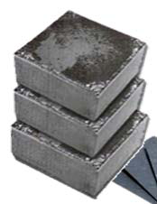
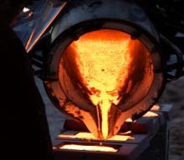
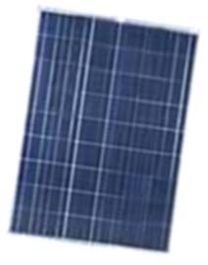
Potential Solutions along the value chain Photovoltaics
Solar cell
MgSilicon
Polysilicon
Ingot & Wafer
Module

Slide 16
First Phase
Manufacturing process to produce Metallurgical Silicon
This step can be done using existing local industrial facilities in Egypt

Slide 17
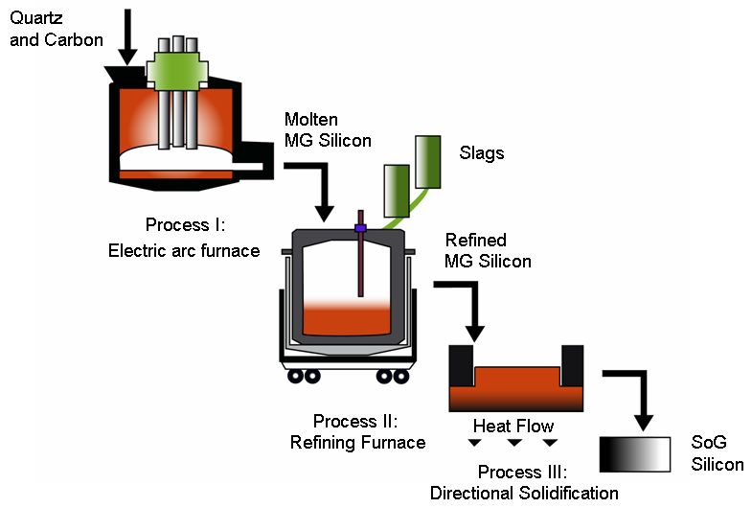

Slide 18
Second phase
Manufacturing process
to produce of polysilicon

Slide 19
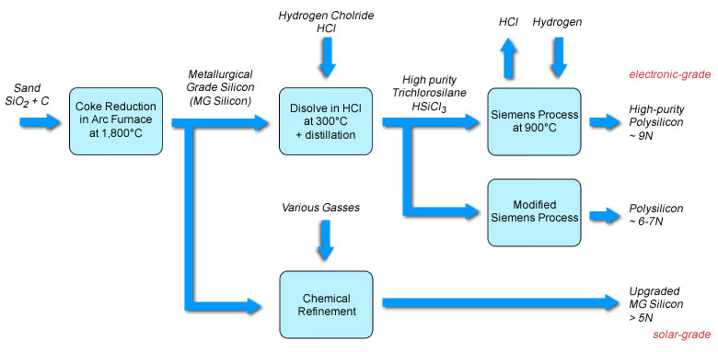

Slide 20
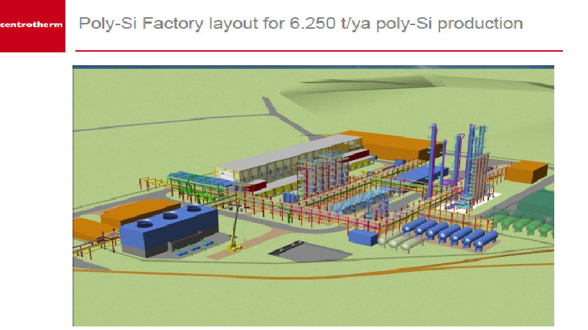

Slide 21
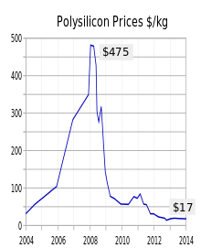

Slide 22
Third phase
Manufacturing process to produce
Ingots and Wafers

Slide 23
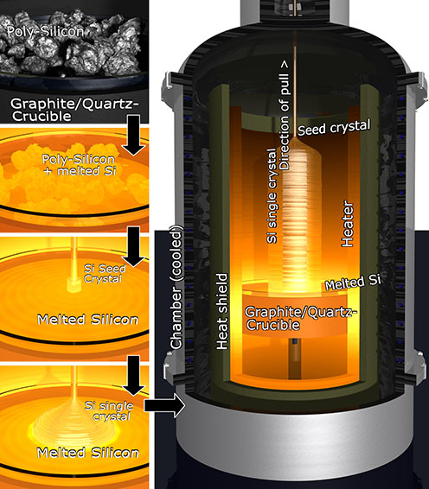
Silicon Ingot Production:
Czochralski and Float-Zone Technique

Slide 24
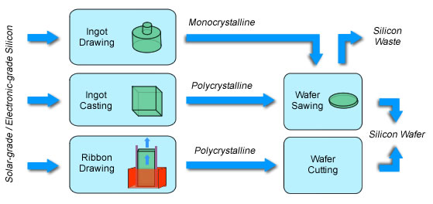

Slide 25
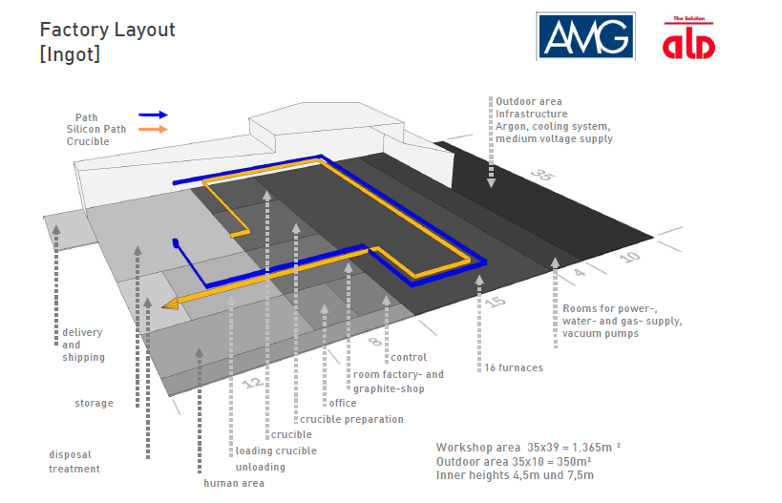

Slide 26
Fourth phase
Manufacturing process
Photovoltaic solar cells
PV solar Cells

Slide 28
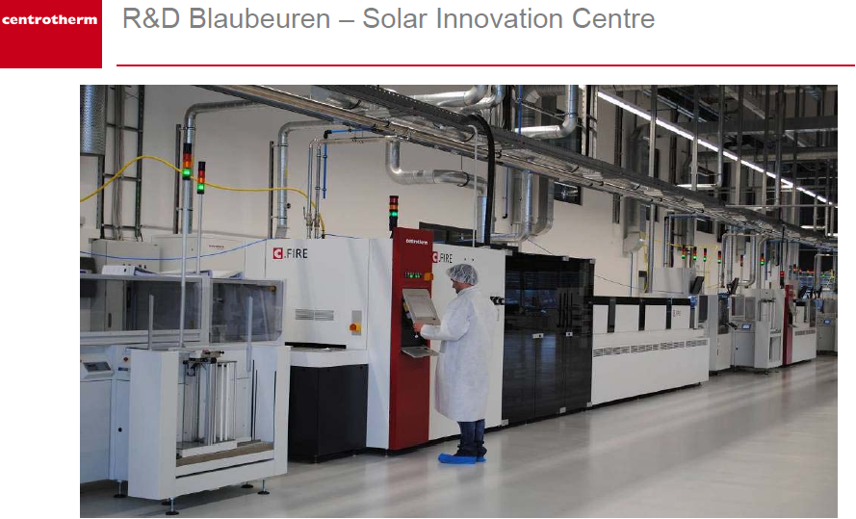

Slide 29
Fifth phase
Manufacturing process to produce
PV solar modules

Slide 30
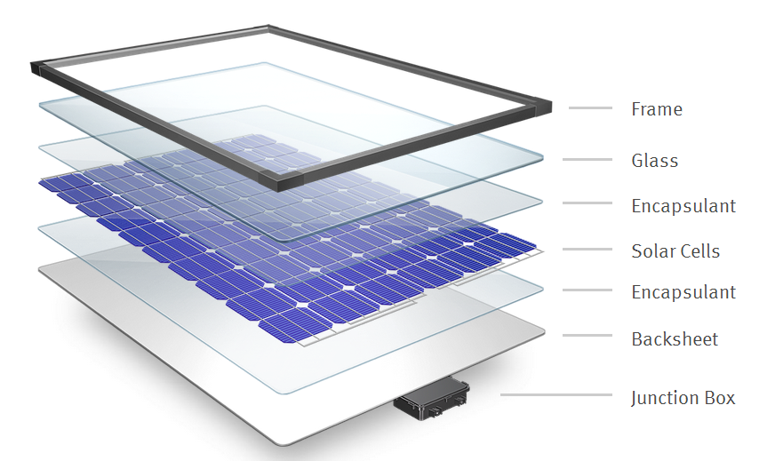

Slide 31
Distribution of PV Solar Farms Cost
Solar Module 50 %
Inverter + cables + installation
50%
Silicon substrate 50 %
Cell processing 20 %
Reducing cost of silicon substrate is one of the most important issues in PV industry.
Module processing 30 %

Slide 32
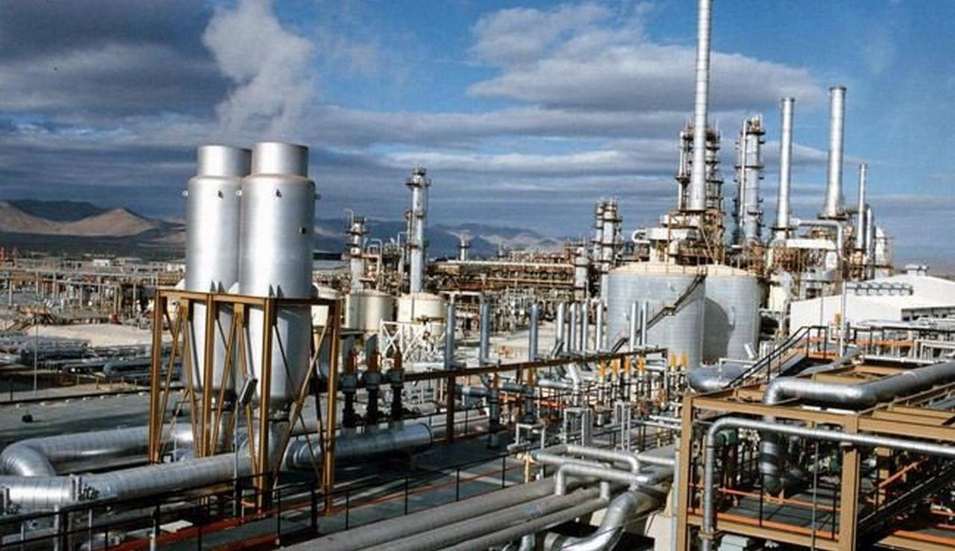
National industrial and agricultural projects for Egyptian sustainable development
The national project of petrochemical
Gen. Dr. Eng. Mustafa Hadhoud
Chairman and Managing director of the Egyptian company for agriculture and rural development
Arab Greek Forum
Athens
From 29-30 November 2017

Slide 33
The national project of petrochemical
Petrochemicals are known as chemicals produced from chemical components extracted from coke, petroleum and natural gas through several advanced industrial processes. These industries have been expanded since 1930 when oil is found at the global level and the German army and Allied armies need industrial materials similar to those of natural materials.

Slide 34
Families of petrochemical materials
Around the world , polymers are divided into five categories: fiber, plastic, rubber, paint, adhesives.
1)Polymers are divided according to their mechanical, thermal, electronic and chemical properties to several families such as: commercial polymers, engineering polymers, biomaterials, etc.
2)The development of polymer properties and increase their competitiveness with ferrous and non-ferrous mineral materials, alloys and ceramics, the development of thermoplastic polymers to engineering thermoplastic polymers, thermoset polymers,

Slide 35
3)Polymers used around the globe include three main families: Natural polymers (cellulose - natural rubber - casein - proteins ... etc)
4)Improved natural polymers (nitrocellulose - cellulose acetate - oxidized rubber ..... etc)
5)Industrial Polymers (Polyethylene - Poly Butadiene - Polypropylene - Poly Strene ..... etc)

Slide 36
Egypt's current and future plan for polymer and petrochemical industries
Egypt started the polymer, petrochemical and composite industries since 1952 as follows: 1) The establishment of factories in the public sector during the fifties and sixties of the twentieth century and factories in the private sector and investment since the seventies of the last century to produce:
Home and engineering products based on plastic polymers.
Industrial sponge products for thermal insulation, furniture and kitchenware.
Rubber products and rubber tires.
Casual and athletic shoes .
Ordinary paints, marine and doku
Adhesives & Resins
Electrical cables, pipes, sockets, plugs
Medical and laboratory supplies and packaging

Slide 37
Egypt's current and future plan for polymer and petrochemical industries
2)Establishment of factories in the public sector during the fifties and sixties of the last century to produce poly-fiber and polyamide fibers.
3). At the beginning of the seventies, the focus was placed on the establishment of factories for the production of polymers used in the plastics industry and fiber industries.
4). At the beginning of the nineties, the focus was placed on manufacturing the required monomers for the polymer industry.

Slide 38
5) In the beginning of the twenty-first century, five-year plans for petrochemical projects have been developed, especially after the establishment of the Egyptian Holding Company for Petrochemicals in the Ministry of Petroleum and Mineral Resources. Since 2001, the following projects have been implemented:
Polypropylene and polypropylene production Factory in Port Said (producing 450,000 tons of polypropylene and 300,000 tons of polypropylene annually)at a cost of LE 1.3 billion egyptain pound
Amethanol methane Factory costing about one billion dollars.
Polypropylene Factory in Ain El Sokhna (Orientals Weavers Co. for Polypropylene)

Slide 39
Poly Stearin production plant (180 thousand tons per year).
Alkyl gas factory (production 8000 tons per year) at a cost of about 200 million dollars
A new factory to produce ethylene and polyethylene (producing 350,000 tons annually) at a financial cost of about 1.5 billion pounds
Factorien to produce nitrogen fertilizers.

Slide 40
Does the local production of polymers and petrochemicals achieve the demands of the Egyptian citizen and the Egyptian industry?
Egypt imports polymers, composite materials, petrochemicals, intermediate chemicals, production materials and additive materials with a financial value of about $ 25-30 billion dollars annually, despite the production projects that have been carried out and are currently being implemented inside Egypt, which explains the importance of focusing during the next phase on deepening the industrialization and local component in this direction. As well as the establishment of new factories to produce other polymers required for the local market and export.

Slide 41
Petrochemical projects to be implemented to meet the demands of the Egyptian market
Light tires, microbuses and passenger cars (Egypt currently imports tires with $ 1.2 billion).
Factoreis to produce Polybutadiene material and SBR material.
Factoreis to produce Poly-ester fibers (Egypt imports three hundred and fifty thousand tons annually.

Slide 42
Factories to produce Polyamide fiber.
Factories to produce Terephthalic acid
Polyurethane raw materials factories.
Styrene factories.
Factories to produce ABS.
Factories to produce gas , kerosene, zinc, butadiene, ethylene and propylene

Slide 43
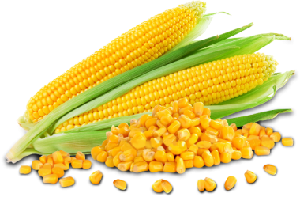
National industrial and agricultural projects for Egyptian sustainable development
National Project for Contractual crops
Gen. Dr. Eng. Mustafa Hadhoud
Chairman and Managing director of the Egyptian company for agriculture and rural development
Arab Greek Forum
Athens
From 29-30 November 2017

Slide 44
National Project for Contractual crops of yellow corn
The project aims to encourage the Egyptian farms to increase the areas cultivated with yellow corn to achieve several national goals, the most important of which is the
reduction of imports (we currently import about 1.6 billion dollars annually )and reduce the area of rice cultivation to save irrigation water and meet the demands And meet the demands of Egyptian feed factories from a local producer and create new job opportunities for Egyptian youth
The Egyptian Company for Agricultural and Rural Development
Ministry Of Agriculture
And land reclamation
Agricultural Bank of Egypt.

Slide 45
The importance of yellow corn
Yellow corn is one of the most important strategic crops. It is the main nerve in the renaissance and establishment of the industries of white and red meat, eggs, milk, dairy products and fish, as it enters up to 40% in the concentrates of red meat and dairy production, and 60-70% other birds and fish.
As well as the use of yellow corn in many different industries are important at the global and local level, such as starch, glucose, yeast, and specialty oils, and some developed countries began to use it as a source of bioenergy after converting it to ethanol.

Slide 46
Information about yellow corn
The global price of yellow corn from 147.45 dollars per ton in June to 147.90 dollars per ton by July..
Egypt imports yellow corn annually with 1.6 billion pounds, equivalent to 8.5 million tons, which represents 80% of domestic consumption.
The increase in the import rate is directly reflected in the prices of meat, poultry and fish of all kinds after the decision to liberalize the exchange rate.

Slide 47
The role of the Egyptian Company for Agricultural and Rural Development in the national project and the contractual crops of Yellow maize
The Egyptian Company for Agricultural and Rural Development participates in the implementation the contractual crops for yellow maize programs as a means to encourage farmers to cultivate the maize as an alternative to rice and the ministry of agriculture to determine the price of adequate supply for the Egyptian farmer and set it during 2017 at the price of 3200 Egyptian pounds per ton grain.
The Egyptian Company for Agricultural and Rural Development is responsible for financing from the Agricultural Bank of Egypt to purchase yellow corn from the Egyptian farmers and to carry out drying, unloading, packaging and selling operations for local feed factories, poultry producers and animal breeding farms.

Slide 48
Cooperation with the Ministry of Agriculture and the Agricultural Bank of Egypt
It was agreed with the Ministry of Agriculture and the Agricultural Bank of Egypt to start in 2018 to purchase a crop of 70 thousand acres in all governorates of Upper Egypt and the process of drying based on sunlight and then the separation process depending on separators will be supplied by the Ministry of Agriculture.
The Egyptian Company for Agricultural and Rural Development
Ministry Of Agriculture
And land reclamation
Agricultural Bank of Egypt.

Slide 49
Project Elements
Ministry of Agriculture and Land Reclamation
Agricultural mechanism sector in the ministry of agriculture
Union of Poultry Producers for Feed Producers.
The supply of corn per ton was announced for a price 3200 L.E
which means 448 pounds by receipt of the vineyard 190 kg 15% moisture and is now on the completion of the executive regulation of the law of contractual crops to ensure the right of the farmer.
Coordinating with the Federation of Poultry Producers and Feed Producers and the Egyptian Company for Agricultural and Rural Development to ensure marketing and the price that achieves profitability and specifications required for supply.
Through its units and stations in the governorates, in which it the Ministry will provide us with corn separators according to a regulated protocol
The Egyptian Company for Agricultural and Rural Development
Agricultural Bank of Egypt.
The company will build the dryers and storage silos for food and receive them from the farmer and then marketing them to the poultry and feed companies
Which is financing the Egyptian company for Agricultural and Rural Development to receive Yellow maize.

Slide 50
Value of sales and profits of yellow corn activity
Annual profits | Value of annual sales | Annual Sales Quantity (in thousands tons) | Financial year
24500 | 350000 | 100 | 2018
49000 | 700000 | 200 | 2019
73500 | 1050000 | 300 | 2020
110250 | 1575000 | 450 | 2021

Slide 51
Gen. Dr. Eng. Mustafa Hadhoud
Greetings from Egypt
Greetings from Egypt

