Slide 1
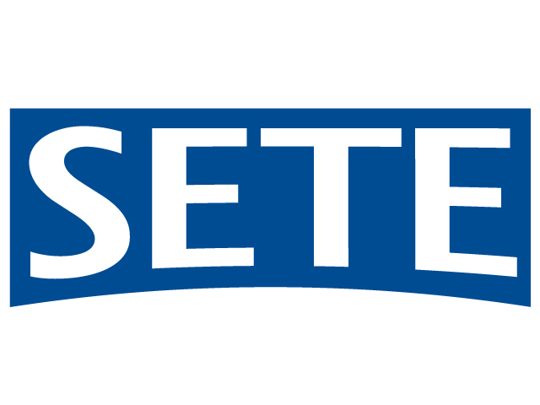
Notes:
Today I am representing the Association of Greek Tourism Enterprises (SETE), the official industry body representing the entire sector. Every investor interested in tourism and local know-how, it is imperative to contact us. We are a fully empowered organisation comprising:
The official industry body for the entire tourism sector (SETE)
The SETE Institute (inSETE) that handles all public funds administered towards the industry, including the voucher for your employment, the subsidies for learning and job experience, as well as all national and European programmes aiming to improve the sector’s effectiveness and competitiveness.
Marketing Greece SA, a 100% private company that has, by law, as its mission to complement the work of the Greek National Tourism Organisation in promoting and marketing the country’s tourism product worldwide.

Slide 2
Notes:
Furthermore, today I am also representing our family group of companies, with Elounda SA at its core, a founding member of SETE. We are the third generation of tourism professionals, as both my parents and grand parents contributed the utmost in making Elounda, in Eastern Crete, as early as the 1960s, the market-leader in Greek tourism destinations.

Slide 3
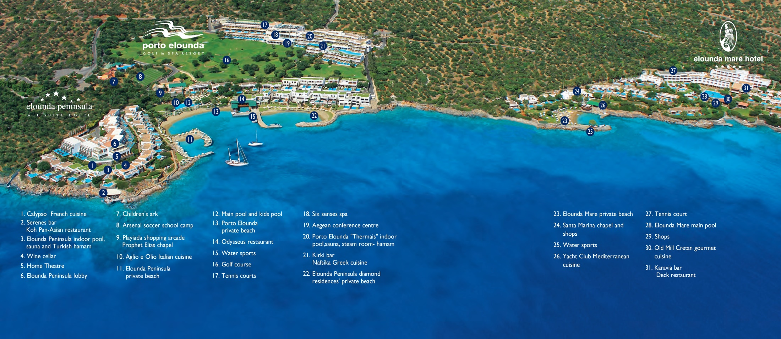
Notes:
The aerial photo of our hotels shows: the Elounda Peninsula on the left, Greece’s top hotel in terms of average daily rate, having achieved an ADR of €700 in 2017. Within the same complex resides also Porto Elounda, with the first golf course on Crete, the first Six Senses Spa, and the only hotel that operated year-round in its wider area. Finally, on the right of the picture, is the Elounda Mare, the first member of the prestigious Relais & Chateaux chain in Greece. In the larger Elounda area, my family has developed and sold another four luxury resorts.

Slide 4
Notes:
In our group, the arm that develops properties for sale is my company, Elounda Real Estate, an activity that developed out of the hotel operation, as an add-on and expansion, based on the success of the Elounda Peninsula All-Suite Hotel. Our family had made sure, as early as the 1970s, to have a number of friends purchase property in the area, guests of our hotels, many of whom have built second homes there. Over the last few years, we have materialised sales of residences with unit prices up to 20,οοο€/m2.

Slide 5
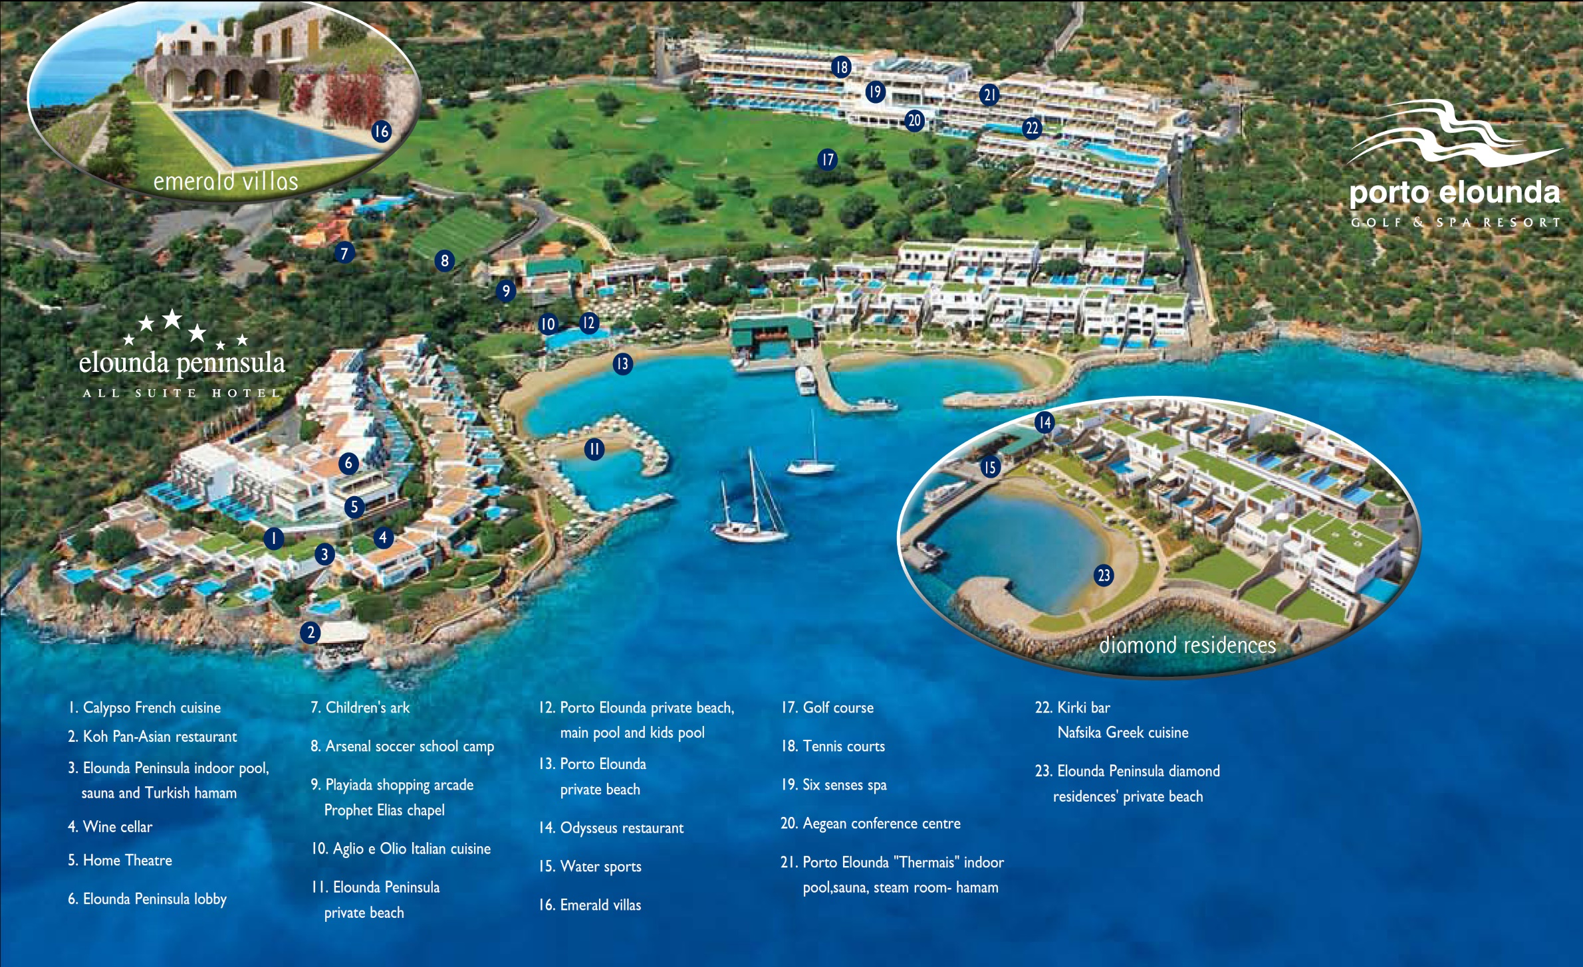
Notes:
Within and around the Porto Elounda and Elounda Peninsula complex we developed two different residential products: first, the seafront residences inside the resort which you see in the aerial photo as the “Diamond Residences” and second the “Emerald Villas” outside the resort, which nevertheless have access to all the resort facilities. Nowadays, the “Diamond” complex of resort residences falls under the provisions of the Law for Integrated Resorts, a very agile investment vehicle, more so than the “Complete Tourism Areas” and considerably superior to private town planning.

Slide 6
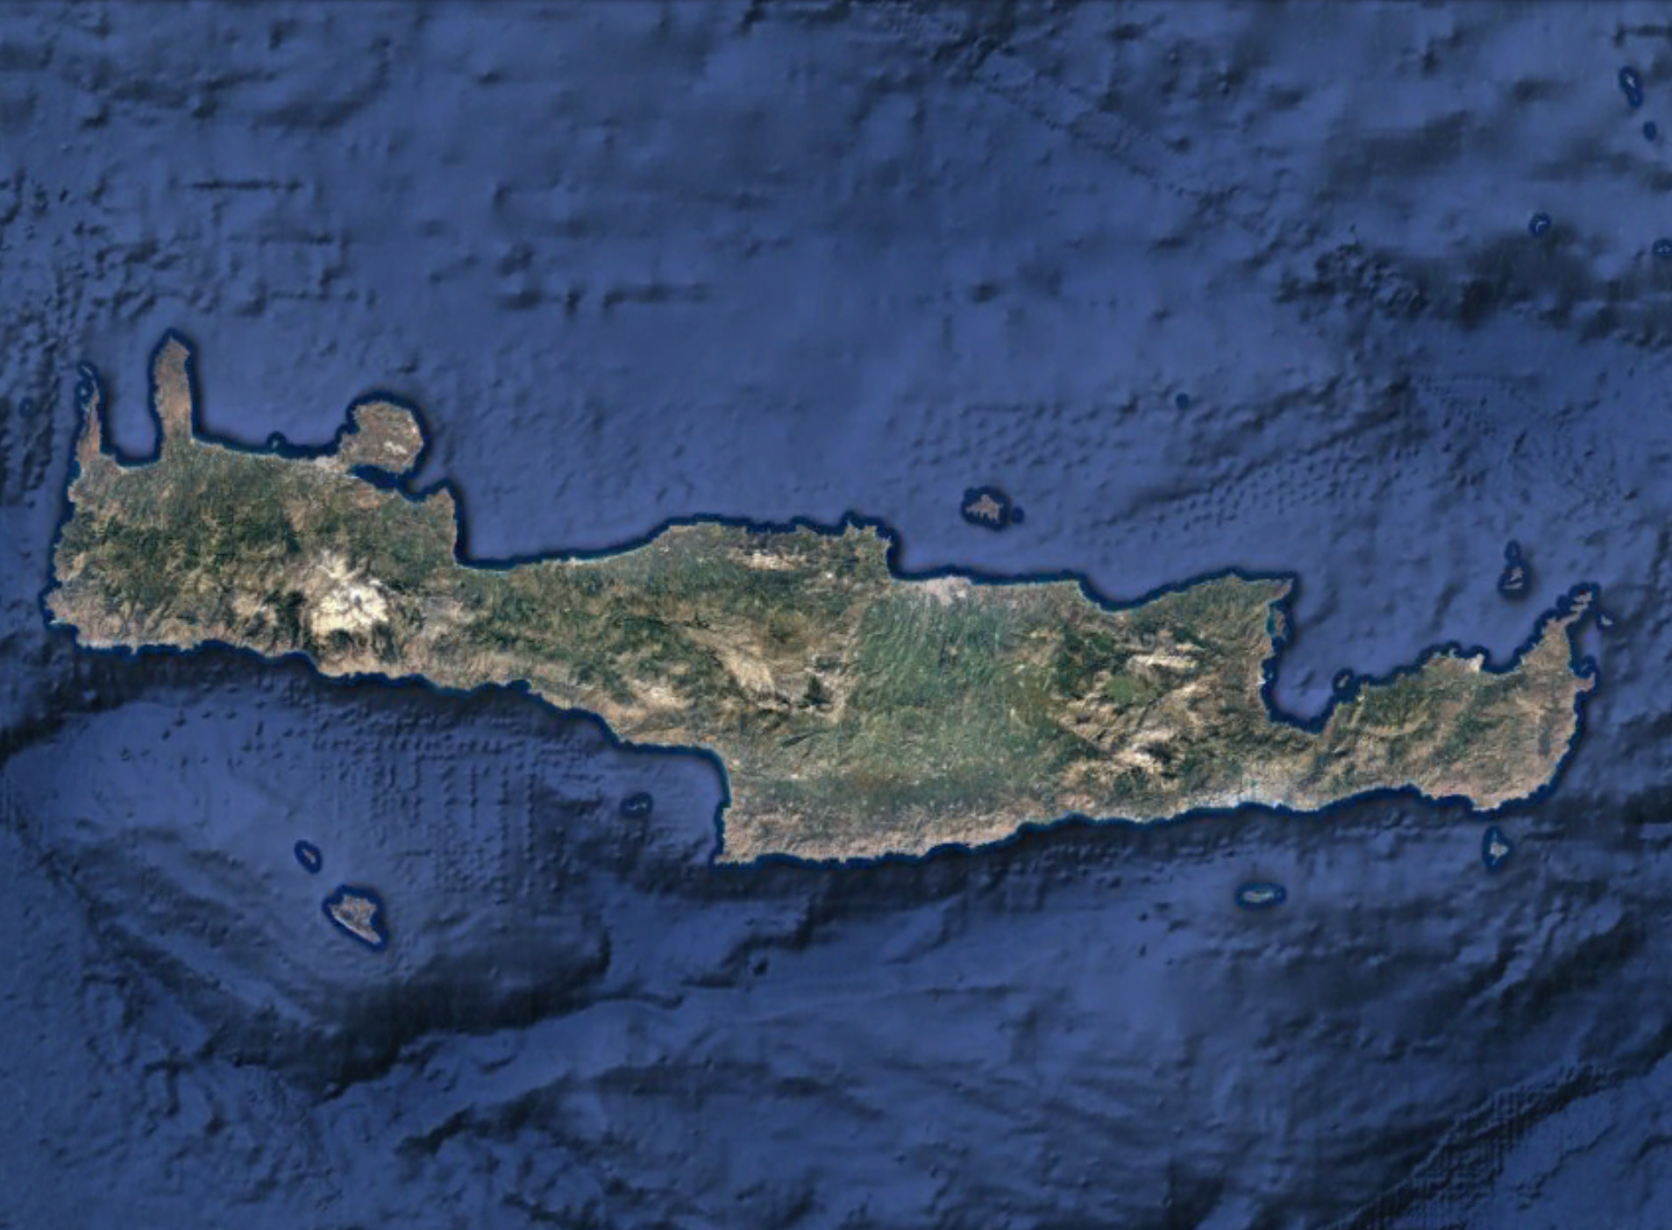
Notes:
Our resort lies on the western side of the Mirabello bay, on the northeastern coast of the island of Crete. Around us, within a 90-minute drive radius, are four more large investments of the “integrated resort” type, with similar characteristics, in various stages of development. They are all available to investors: starting from the east, we first see the Cavo Sidero resort developed by the Minoan Group, the Sitia Bay Resort by Dolphin Capital Investors, the Elounda Hills project by Moscow-based developer MIRUM, as well as the last private town plan permitted on Crete, the Golden Beach Resort on the southern coast. Two of these development can be wholly acquired by an investor.

Slide 7
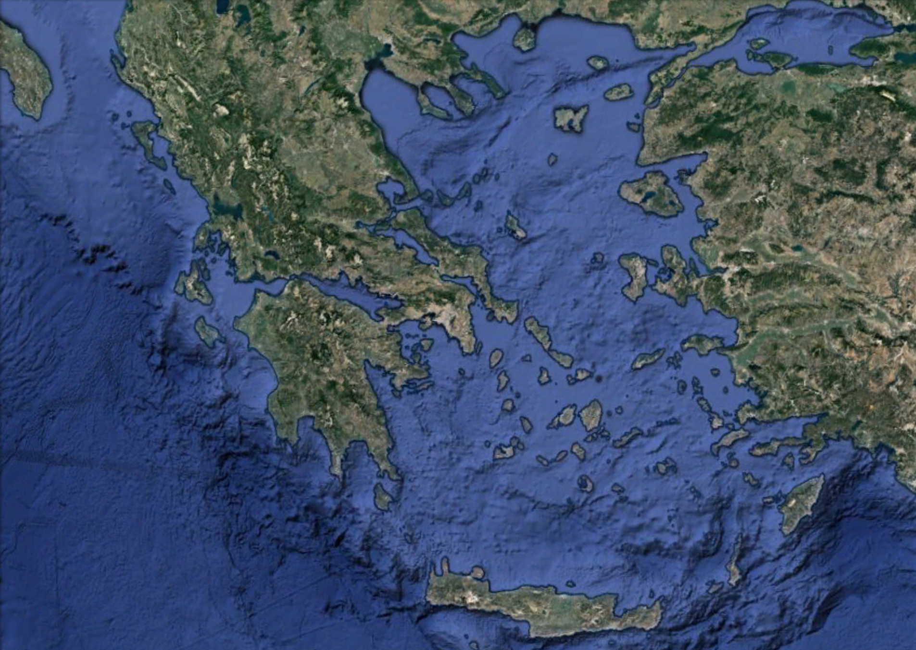
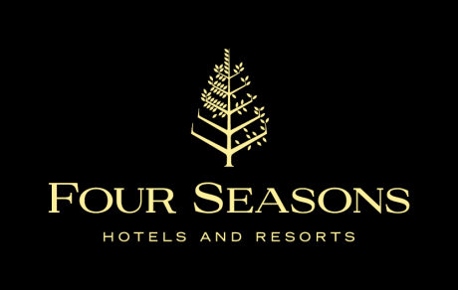
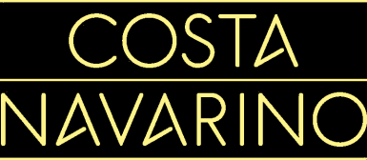
Notes:
At the same time, throughout Greece, a series of such investments have been realised in major resort locations: in Halkidiki, for example, near the famed Porto Carras and Sani Resort, many new ones have sprung up or are currently proceeding, like three major integrated resorts (the two former XENIA hotels, privatised recently, and the Miraggio thermal spa resort in Kassandra, already in operation). Of course, there’s Costa Navarino in the Peloponnese, where three new golf courses will soon be added to the existing two, so that Greece finally has a destination that can complete on par with the famed winter golf destinations in Spain, Portugal, Turkey, and Cyprus. The Amanzoe resort in Argolis has already effected sales of over 80m€ in villas, and we expect something similar to happen also at the new Four Seasons scheduled to open in 2018 at the site of the former Astir resort. On the map we also note the Cassiope investment in northern Corfu, and Afandou in Rhodes, both being underway. Special mention must be made of the largest investment in the entire Mediterranean region, the Hellinikon in Athens.

Slide 8
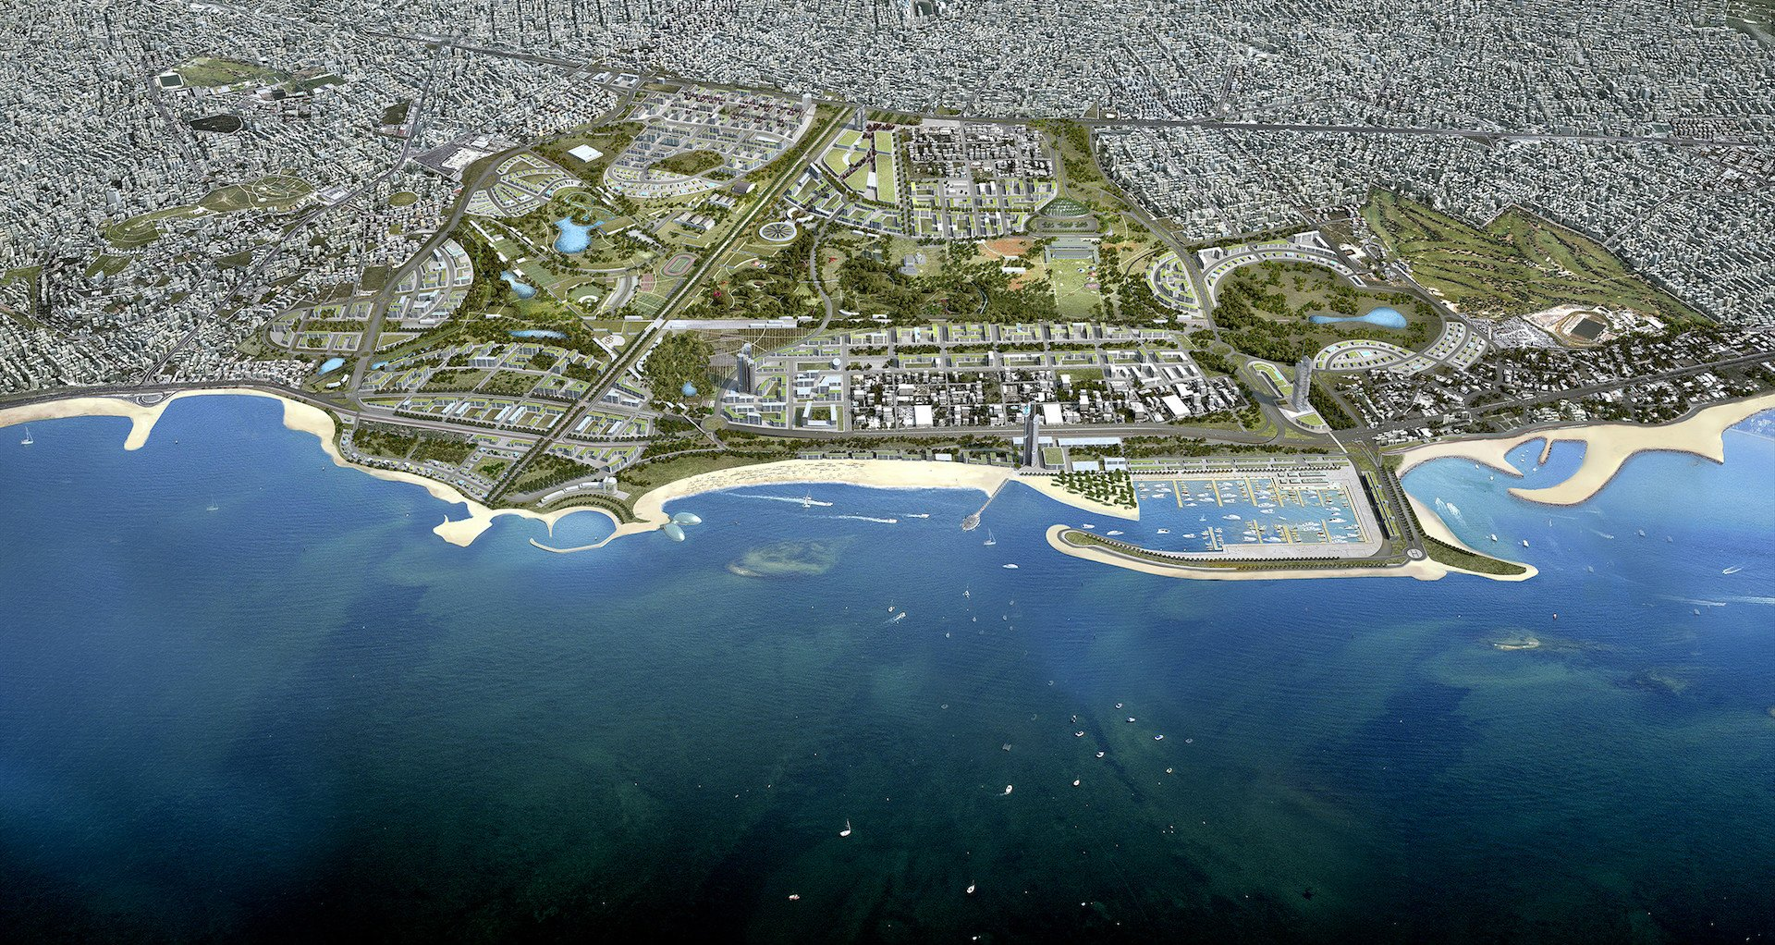
Notes:
The Hellinikon project is the site of the former Athens International airport. This summer, I met in Crete with the Mega-resort Development Director of a major American casino company, who stayed at our hotel in Elounda and was shown around the island of Crete. We had the opportunity to discuss a series of investments in casinos, and –of course- the Hellinikon was the main topic. This is a project that can, at full scale, reach the amount of €8bn, which is by far the largest European investment at this time. The record was set by the Channel Tunnel connecting the UK and France, which at today’s rate was equivalent to €6.5bn. And by virtue of its enormous size, the Hellinikon can the capacity to draw many other major investments around it and along the entire coast of Athens, the so-called “Athens Riviera”, which reaches all the way to Cape Sounio and has a multitude of excellent locations for resorts.

Slide 9
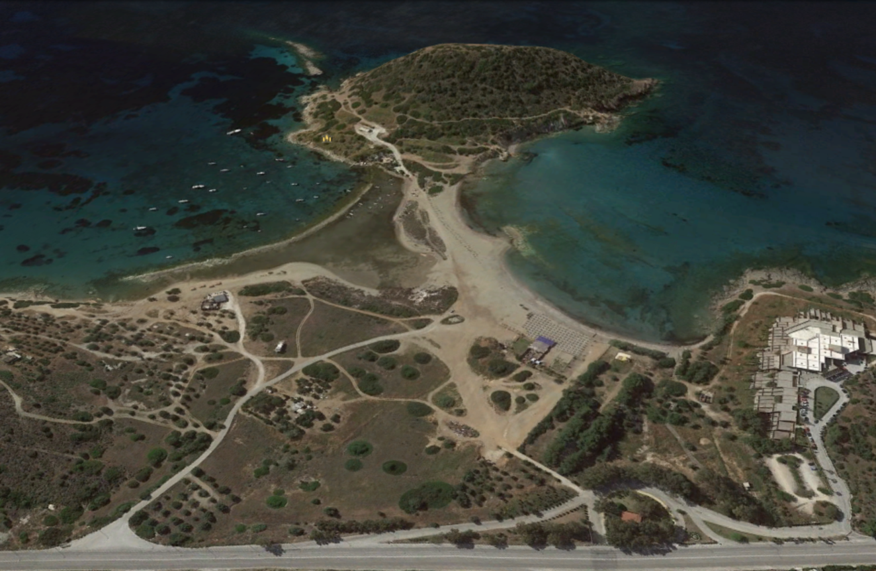
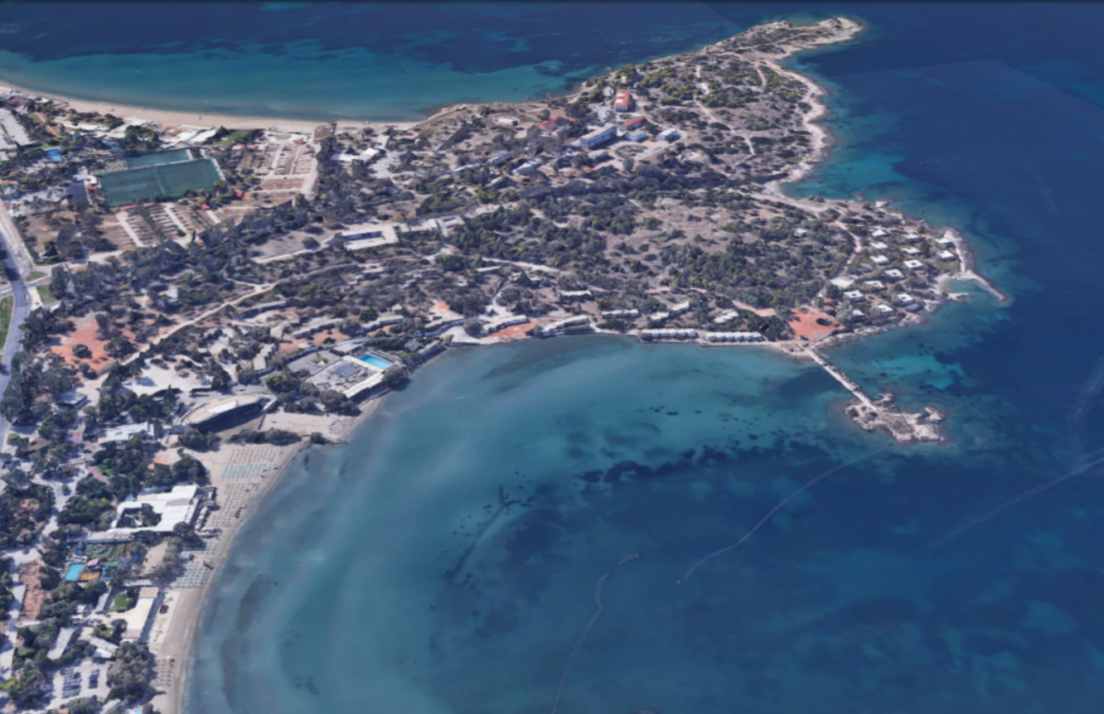
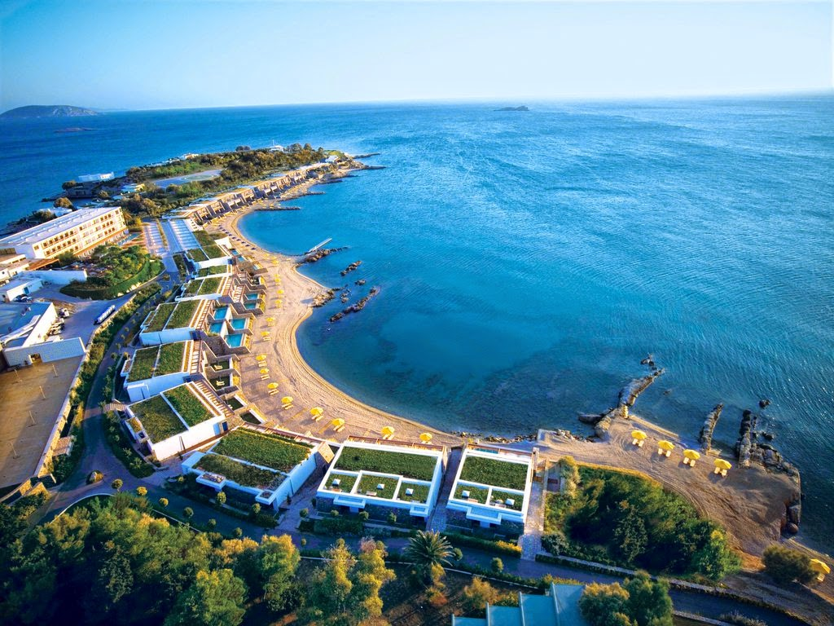
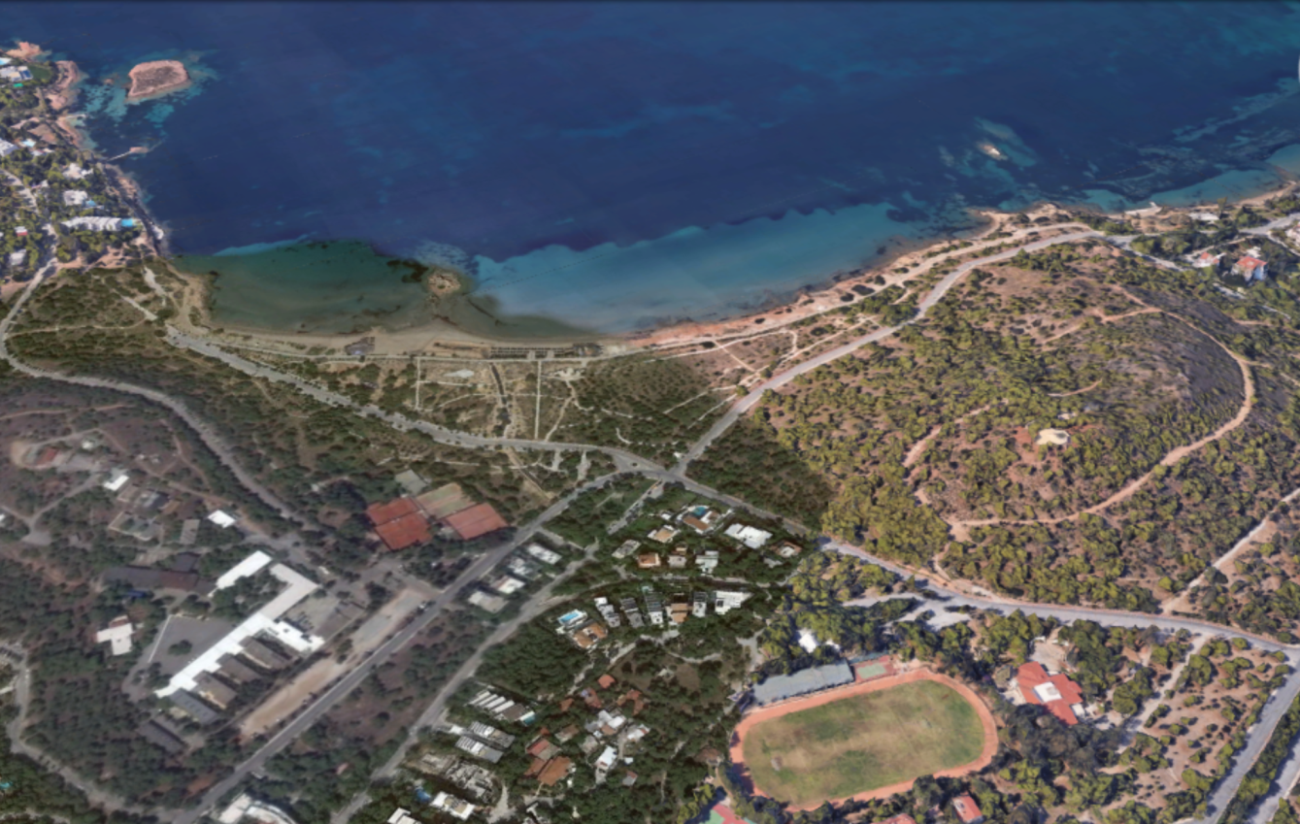
Notes:
On the screen you will see a few typical locations for such tourism projects along the Athens Riviera. On the bottom right, we have Grand Resort Lagonissi, which has already published a call for strategic investors to enter into cooperation with the lease holder, which on the top right you see Asteria Glyfada, a fomer resort with similar location to the Four Seasons in Vouliagmeni, wherein Grivalia (the REIC arm of Eurobank) is moving ahead with a €60m integrated resort. By the way, on the southern side of the Asteria complex, at the top of the screen, you can clearly see a similar plot which is still public property, a dilapidated foundation, where another large tourism investment could take place, whose revenue could be used to fund any such foundation at any other location in the country. A similar situation is depicted in the other photos, on the left: a public beach in Kavouri, where some of the most expensive real estate in Greece is found, where you can see at the bottom left a large facility owned by the Air Force (!), and on the top left another public beach, this one in Anavissos, further down the road from Lagonissi towards Sounio, where an old hotel currently houses a public school of tourism studies. These public functions could function equally well in other locations, not on the coast, freeing up this land for re-development.

Slide 10
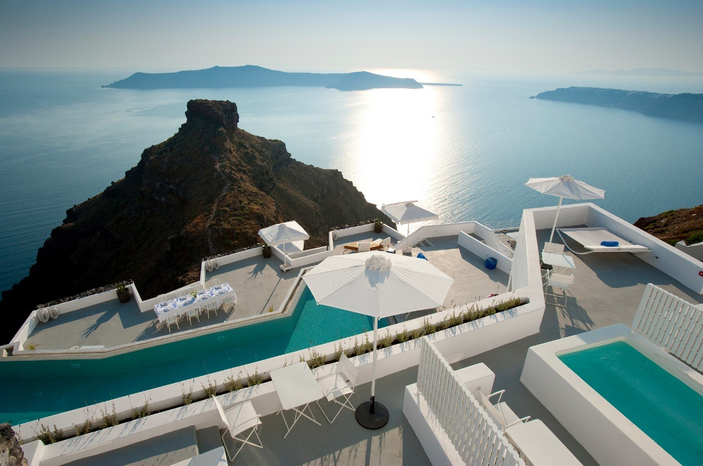
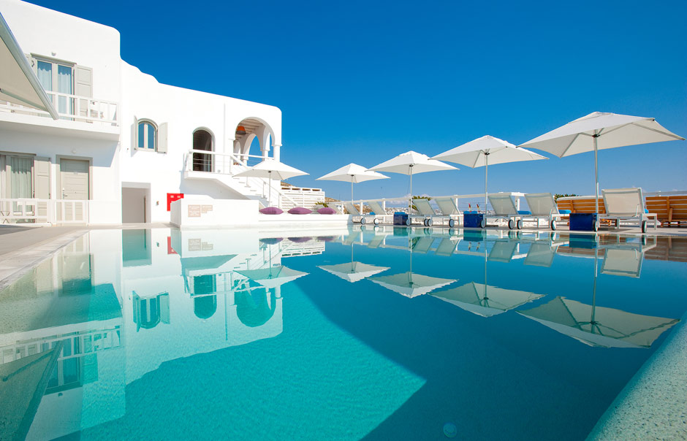
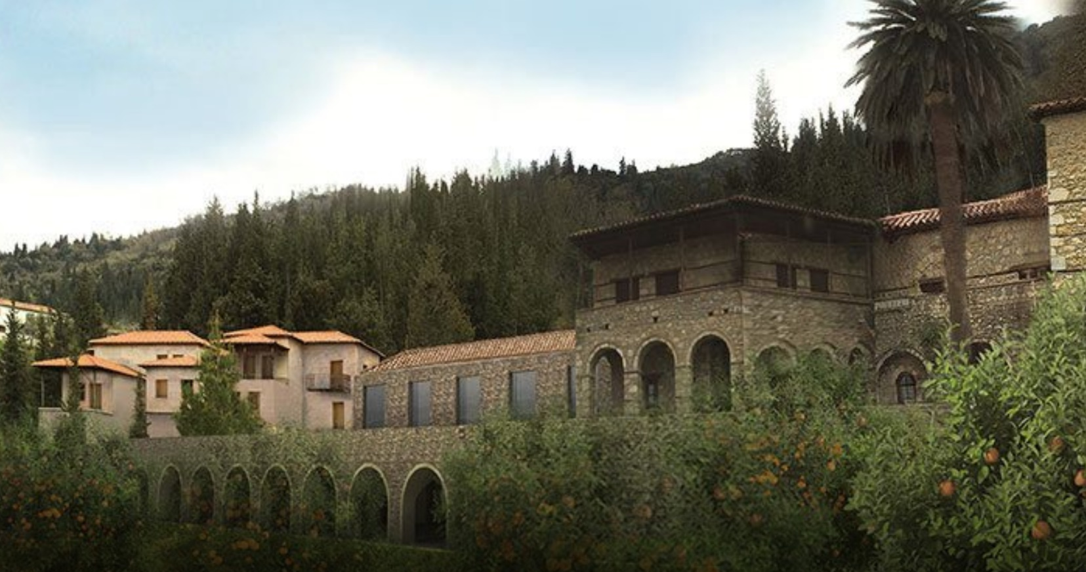
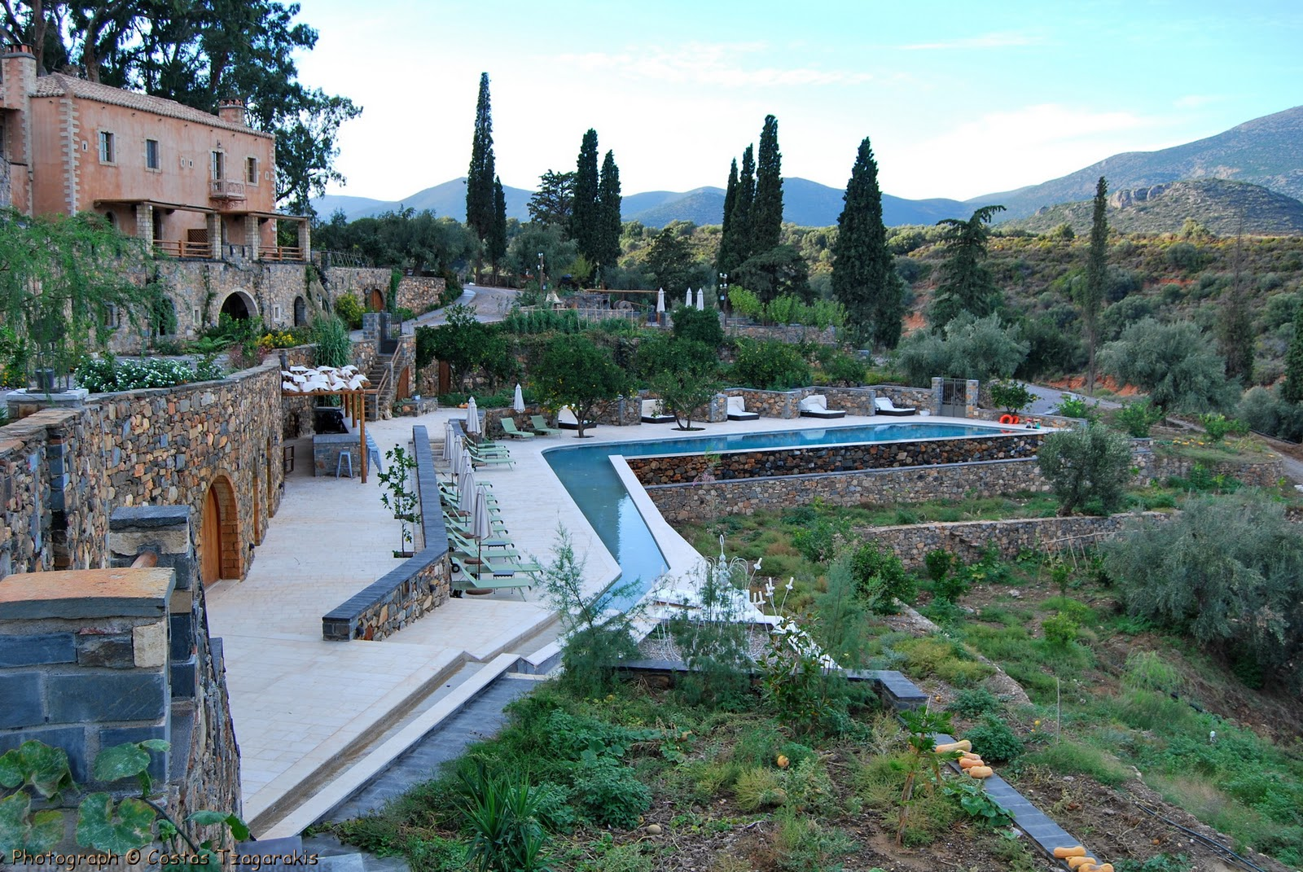
Notes:
Besides the mega projects, however, Greece has even more opportunities for smaller scale investments. Some project where I have personally been involved are pictured here. Clockwise from the top left you see Santorini, Mykonos, Monemvasia, and Mystras, near Sparta. These are cases where the investor acquired projects that were at some stage of development or were outdated, and turned them into veritable gems. The crucial aspect for the success of such ventures id the management of the hotel operation after the project is delivered. This is where the upside will truly materialise. It is in this field that Greece has nowadays produced considerable know-how, for “turning around” a hotel operation. You see, the core of Greek tourism have always been SMEs, almost always family-owned and managed. There are numerous such investments in Greece that, with the correct investment strategy, can turn into success stories.

Slide 11
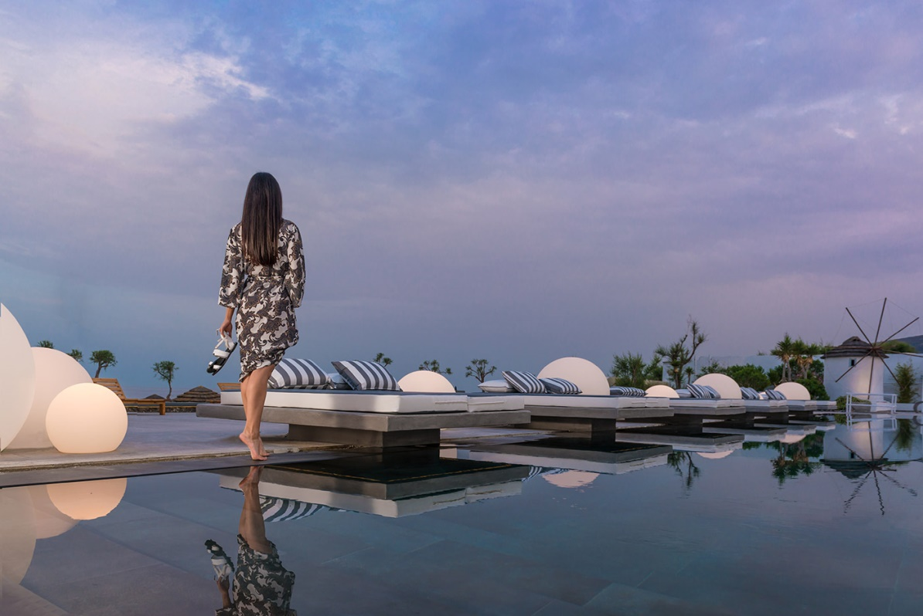
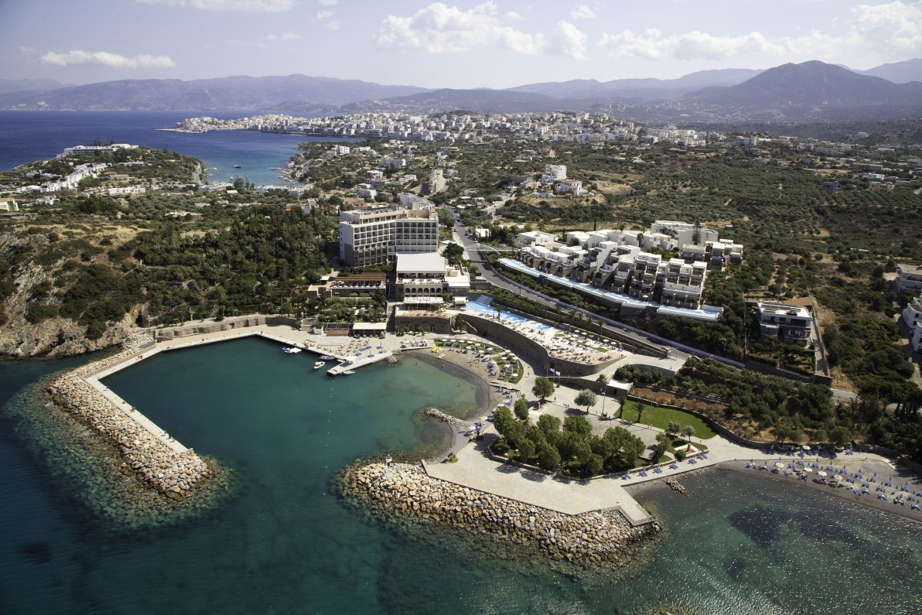
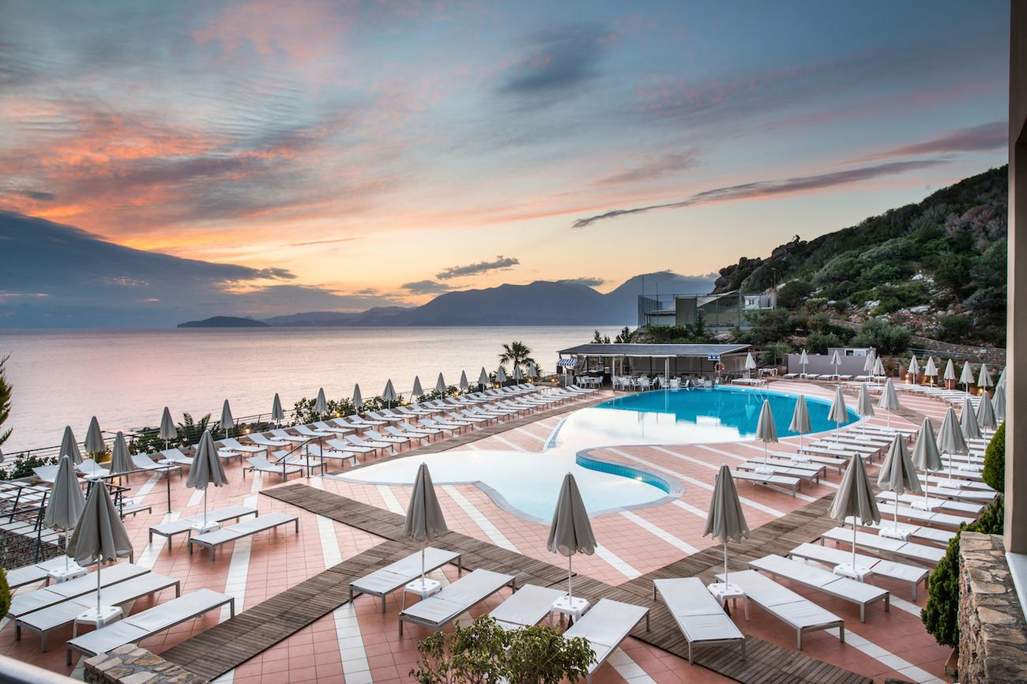
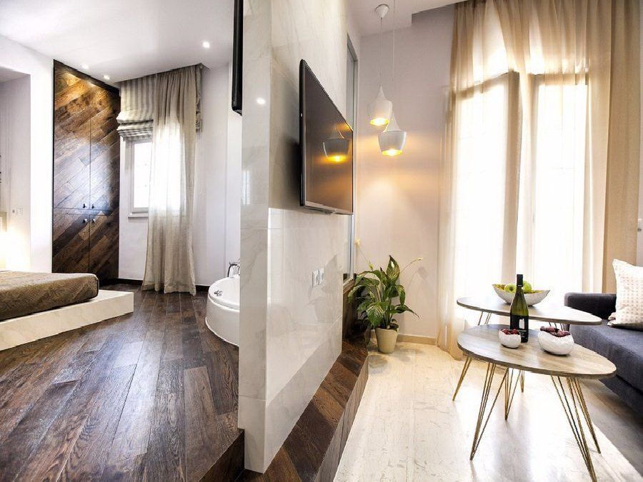
Notes:
We showed investments starting from scratch, the so-called “greenfields” (like the one at Cassiope in Corfu), “brownfields” where an abandoned or non-operational asset is turned into a business (like in the case of Afandou in Rhodes), and we saw the acquisitions of operating properties, like the Astir in Vouliagmeni. Let’s take a closer look at this category now, purchasing operational hotels, and the kind of investment strategies these could be targets of.

Slide 12
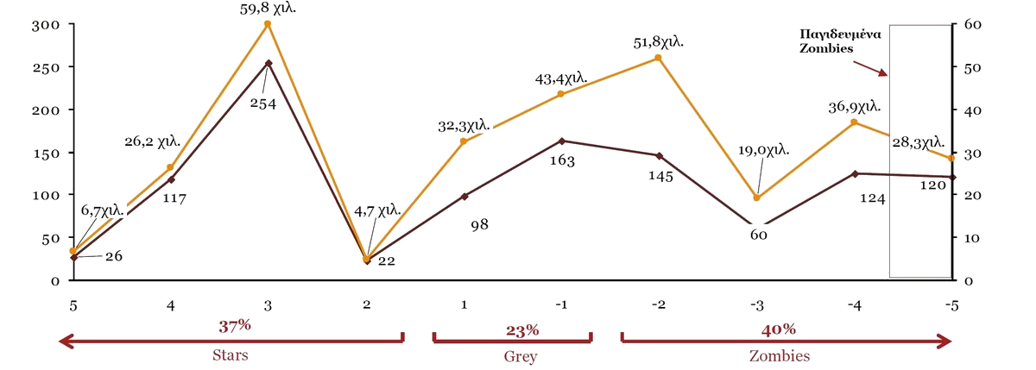
Greek Hotels: Star vs. Zombie
No. of Hotels
No. of beds
Trapped
Source: PwC, 2016
Notes:
Price Waterhouse Coopers published in 2016 a study of 754 hotel companies, which hold 1,129 hotels and show annual revenues of over 1m€ in any year between 2008 and 2013. Only 367 of these hotels have more than 300 beds (approx.150 units), representing only 4% of the country’s total hotel stock but 25% of the capacity. An analysis of financials for these 745 companies placed them in 11 categories, from +5 to -5, where the upper ones were called “Star” lower ones “Zombie”, and intermediates “Grey”. As a professional hotelier and developer, I must note that published financial data do not reveal everything about a company, especially when we’re talking about SMEs in Greece. Therefore, specialists must also perform a due diligence, if even for a day or two, in order to reveal the true picture.

Slide 13
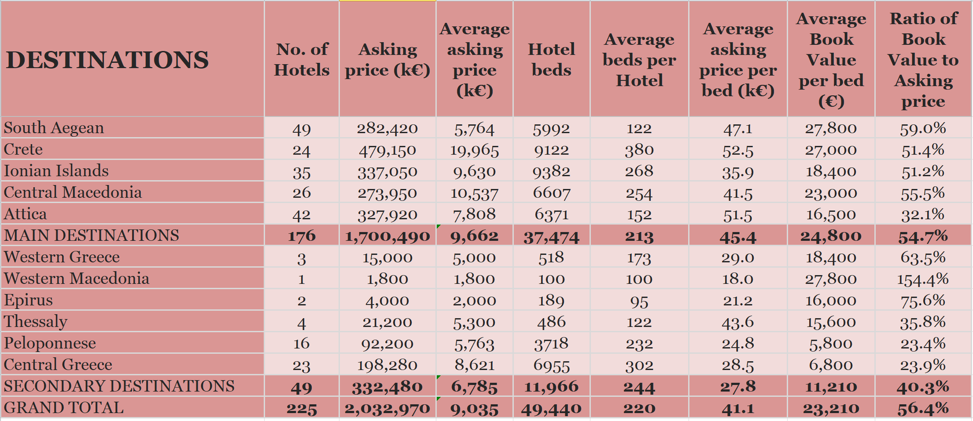
225 Greek Hotels on Sale
Source: PwC, 2016
Notes:
The PwC study showed that there are 225 hotel properties available for sale at that time. Out of these, the vast majority (176) were in the main tourism destinations (Crete, Aegean Sea, Ionian Sea, Attica, Halkidiki, etc) while only 49 were in the secondary destinations (e.g. the Peloponnese). What is particularly interesting in this table, among many other intiguing data, us whether the asking price is close to the book value of the companies, as shown on their balance sheets, and it shows that –on average- a strict investor would ask for a discount of between 40% and 70%. There are cases, however, that represent attractive deals, and this is the job of people like myself to find.

Slide 14
INVESTMENT STRATEGY 1
Expand Capacity
Group | Value multiplier (x)
 | 5* | 4* | 3*/2*/1*
Star | 1.6 | 1.7 | 1.6
Grey | 1.6 | 1.5 | 1.6
Purchasing targeted assets in primary destinations (e.g. Crete, Corfu, Rhodes, Halkidiki)
Expansion of capacity by either exploiting some remainder building coefficients or by purchasing some neighbouring properties.
Re-positioning
ROI up to 60%
(Source: PwC, 2016)
Up to 605 hotels in
primary destinations
Target an acquisition price smaller than €120.000/room
Notes:
The first strategy that the PwC study proposed was the acquisition of targeted hotels in primary destinations (e.g. Crete, Corfu, Rhodes, Halkidiki) and subsequently their expansion by either adding capacity or purchasing also nearby plots or buildings. This category includes a large number of potential targets, but the negotiating strategy is likely to be protracted, owing to the high asking prices. Of course, some renovation will be required, but it is preferable to purchase hotels that perform well already (“star”), where the expansion will immediately produce returns on the investment (ROI). In this case, according to PwC, ROI may reach up to 60%, which translates into an IRR of about 10% in 6 years using rather reasonable assumptions: Total revenue per available room (TRevPAR) at 200€, EBITDA margin at 30% and after-tax profits of 15%, which are average characteristics of “Star” hotel companies.

Slide 15
INVESTMENT STRATEGY 2
Upgrade
Group | Value multiplier (x)
 | 4* -> 5* | 3* -> 4*
Star | 1.6 | 1.2
Grey | 1.4 | 1.1
Acquiring under-prforming assets in primary destinations (e.g. Crete, Corfu, Rhodes, Halkidiki)
Upgrade to the next star rating
Re-positioning
ROI up to 70%
(Source: PwC, 2016)
Up to 476 hotels in
primary destinations
Target an acquisition price smaller than €80.000/room
Notes:
The second strategy that the study proposed was acquiring and renovating targeted hotels that under-perform in relation to their potential, in primary destinations that show a lack of adequate high-star-rated accommodation. Lots of candidates can also be found in this category (PwC found 476 from the published financial data), both in the star as well as in the grey group. In this case, according to PwC, ROI can reach 70%, which translates into an IRR of approximately 11% in 6 years, with similar assumptions about operating key performance indices (KPIs).

Slide 16
INVESTMENT STRATEGY 3
Develop Secondary Destinations
Group | Value multiplier (x)
 | 5* | 4* | 3*/2*/1*
Star | 3.7 | 2.0 | 1.6
Grey | 1.8 | 1.8 | 1.5
Εξαγορά πολλαπλών ξενοδοχείων σε δευτερεύοντες προορισμούς (π.χ. Πελοπόννησος, Πάρος, Πήλιο)
Αναβάθμιση στην επόμενη κατηγορία αστέρων
Re-positioning
ROI up to (?) 270%
(Source: PwC, 2016)
Up to 57 hotels in secondary
destinations (20 at reasonable prices)
Target an acquisition price smaller than €50.000/room
Notes:
The third and final strategy regards secondary destinations, like the Peloponnese, Lesvos, and Pelion. There are fewer hotels available in these regions, as PwC indicates about 57, and of these only 20 seem to have a reasonable price-to-value relation. Obviously, an investor would need to renovate the facility completely and reposition it in the market with a new brand identity. However, PwC considers this strategy to hold the highest promise of returns, with an investment in a 5* hotel yielding an ROI of up to 270%, but I must note that my own analysis shows that it’s more reasonable to expect something below 200%. As a matter of fact, running a few models shows a reasonable ROI of 160%, translating into an IRR of 17% in 6 years, assuming the best EBT margins on the market (20%) and a maximum TRevPAR of about 170€ at the point of exit. Those of you who are hoteliers will immediately appreciate how difficult these KPIs are in secondary destinations, requiring very “tight” management.

Slide 17
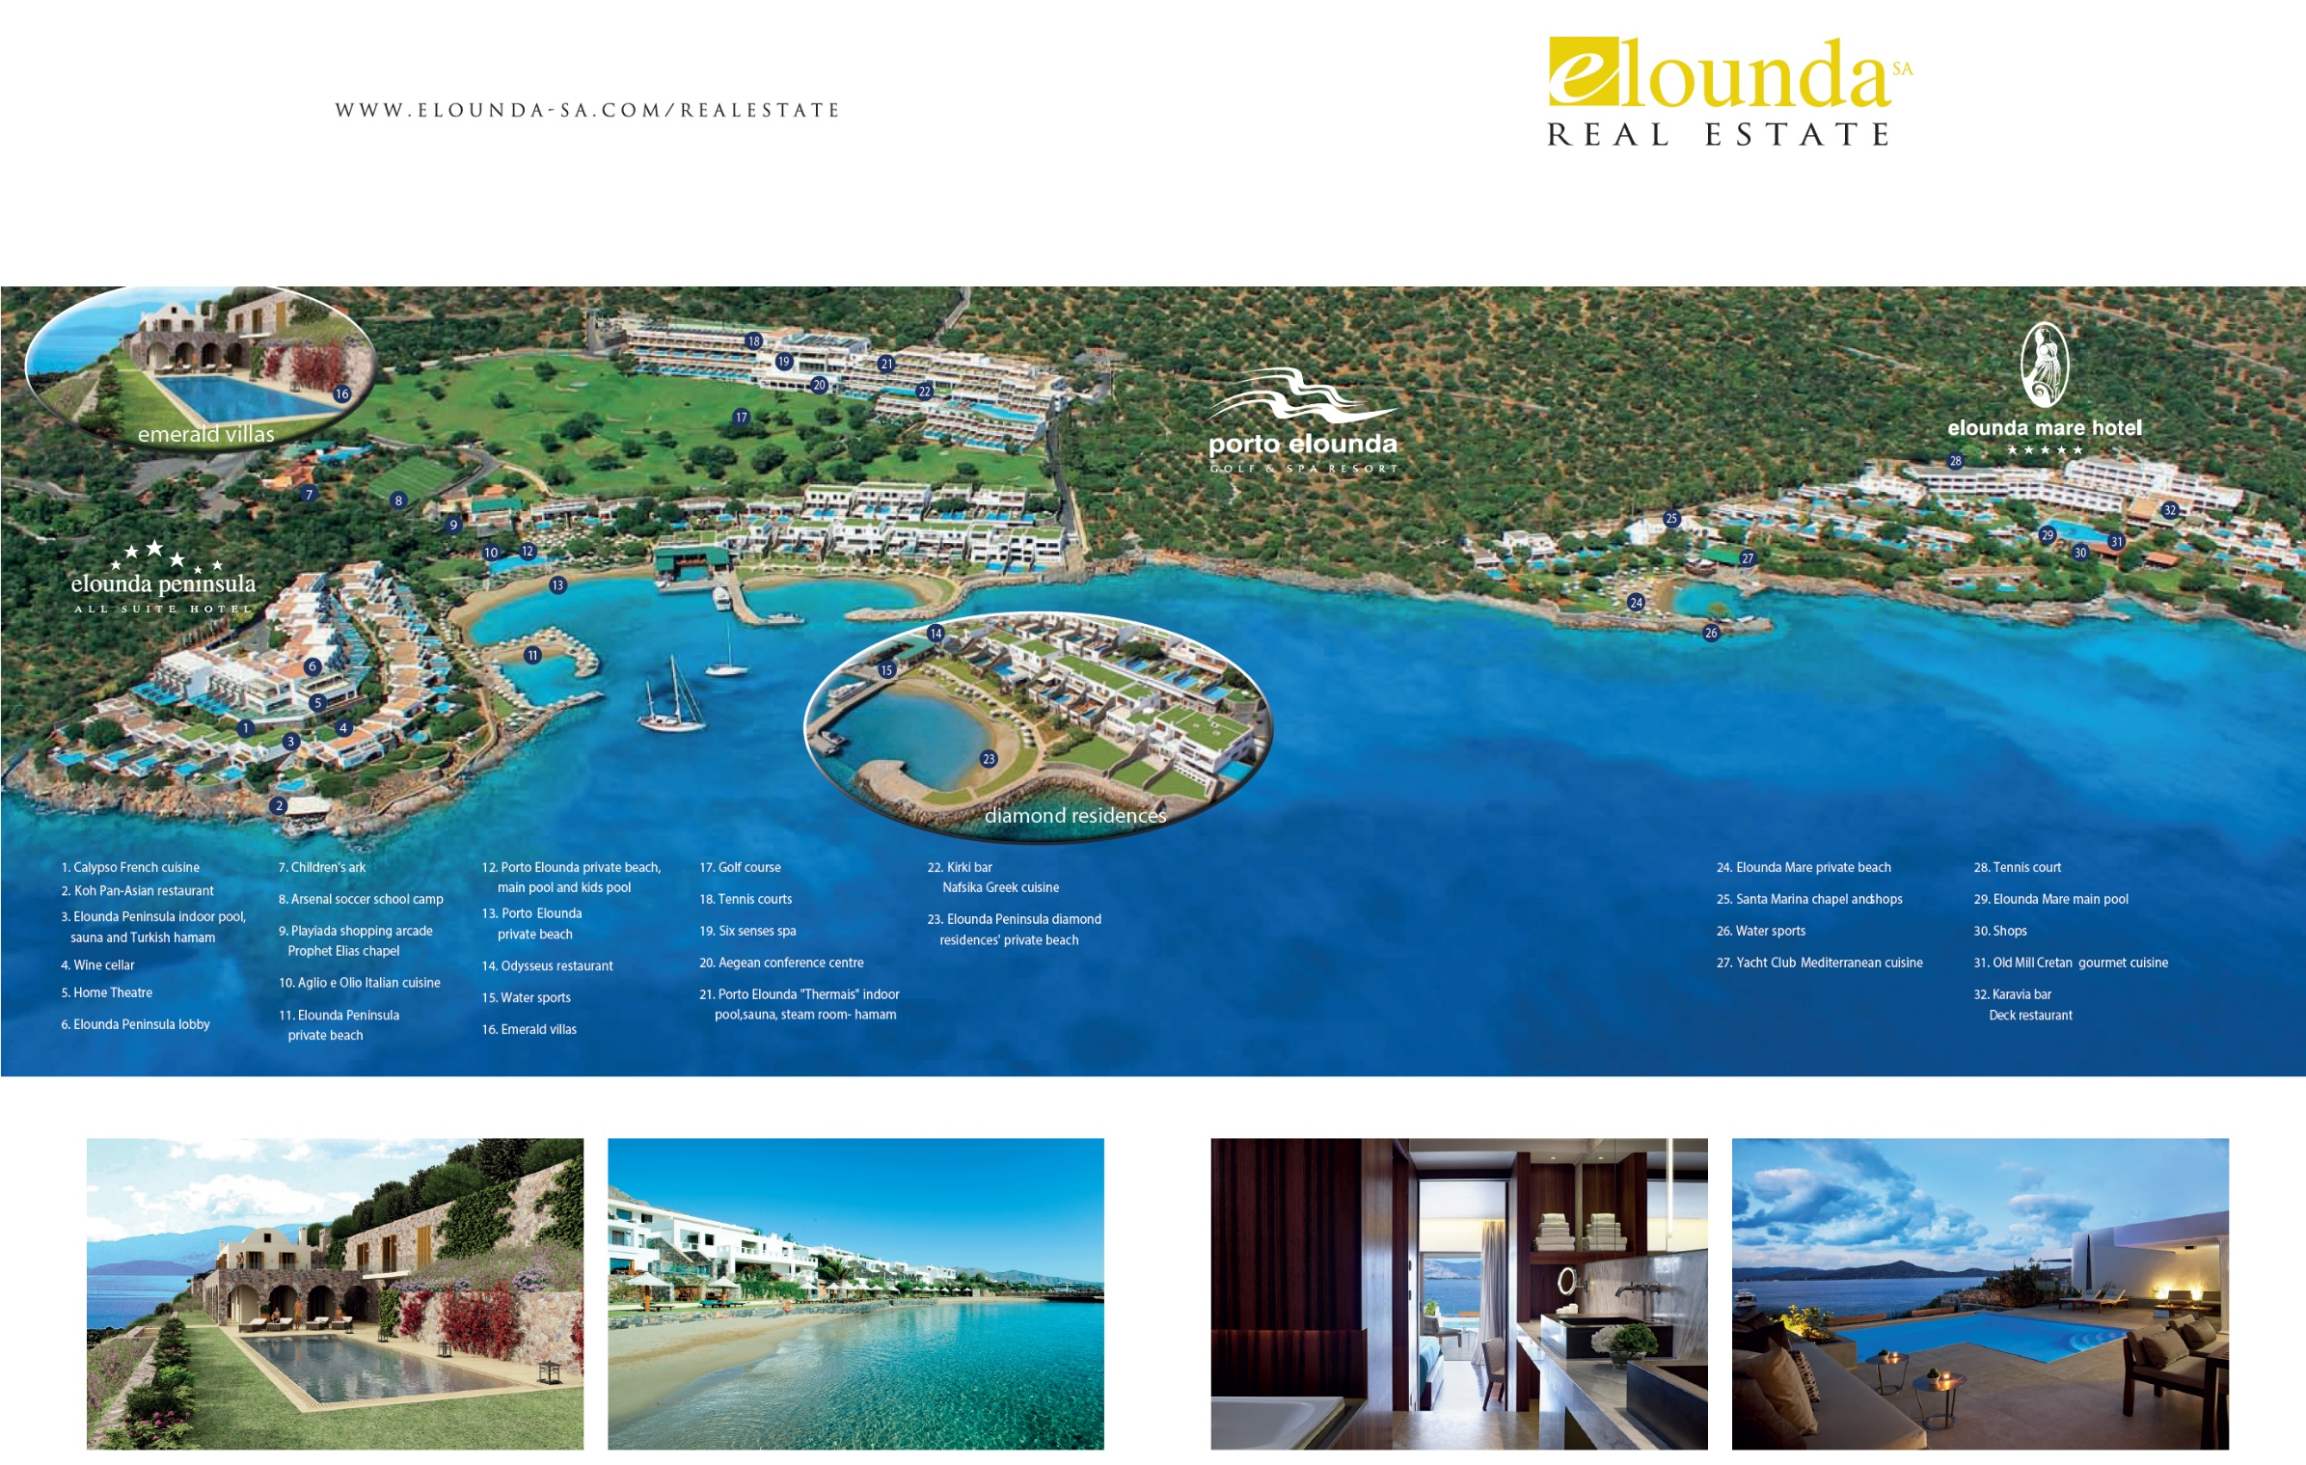
Notes:
Completing tonight’s presentation, I must stress the importance of finding a competent local partner when investing in Greek tourism, whom the investor may wholly trust for the fruition of their investment. We at Elounda SA and Elounda Real Estate have developed our know-how over decades, with an impeccable track record of creating market leading hotels, some of which remain under our ownership and some of which we have sold off to third parties. We have also worked extensively for clients investing in other destinations, as designers and as managers. I will be delighted to answer any queries during the panel discussion.

