Slide 1
Market Entry and International Investment Opportunities in Jordan

Slide 2
Rethink Market Access
Think of investing in Jordan as your road to success in emerging, high growth Middle East economies.
Jordan is a land of opportunity located in the heart of MENA that offers a skilled workforce, a high quality of living and competitive business advantage.
Notes:
التفكير في الاستثمار في الأردن، هو الطريق إلى النجاح،
حيث يعتبر الاردن من الاقتصاديات ذات النمو المرتفع في الشرق الاوسط
الموقع المتميز للاردن في الشرق الاوسط
يمتاز الأردن بتوفر الأيدي العاملة الماهرةهي أرض الفرص تقع في قلب الشرق الأوسط التي، وذات جودة عالية من المعيشة والميزة التنافسية في قطاع الأعمال

Slide 3
Why Jordan Jordan presents clear enablers to help your business grow
Security and Stability
Modern & well connected infrastructure
Skilled & talented human capital
Market Access
Access to over 350 million consumers in the MENA region
Access to over 1 billion consumers globally through bilateral and regional free trade agreements with:
EU Association Agreement
European Free Trade Agreement
Agadir Agreement
Greater Arab Free Trade Agreement
USA, Canada, Singapore, and Turkey
World class Development Zones
Network of roads and railways that connect to the region of over 370 million consumers
Modern telecommunications infrastructure
Telecommunications sector fully liberalized since 2005
World Class international airport and airline, serving over 59 global destinations
Qualified human capital
Talented and bilingual graduates
Expenditure on education is 9.7% of government expenditures
One of the highest country in the world in terms of engineers, physicians, and nurses per capita
Government programs to fill in the gap between market needs and educational output
regional and international relationships
A model of moderation and security
Strong anti-corruption and transparency efforts
Free market principles and respect for investor rights
Reform driven government agenda, particularly in the fields of investment and public private partnerships

Slide 4
Liberal Economy
Growing number of FTAs since 1997
Member of WTO since 2000
117 nationalities in industrial and service sectors own companies in Jordan
49.5% of shares of publicly listed companies on Amman Stock Exchange are owned by non-Jordanians
100% Foreign Ownership
Legal Framework that Encourages Investments
No restrictions on capital transfers and repatriation of profits
55 Bilateral Investment Treaties
27 Double Taxation Agreements

Slide 5
Beyond MENA
Jordan’s virtual hub allows free market access to over One Billion Consumers through its trade and investment agreements
Canada FTA
EU Association Agreement
Jordan-EFTA
US FTA
Greater Arab Free Trade Agreement (GAFTA)
Aghadir Agreement
Singapore FTA

Slide 6
New Investment Law (2014)
Reorganizes the various investment related entities (Jordan Investment Board, Development and Free Zones Commission, and Export Promotion Department)into the Investment Commission.
Creates the Investment Council, chaired by the Prime Minister and with equal representation from the public and private sector
Expanding the sectors covered within the law to include crafts and services, in addition to:
industry; agriculture; hotels; hospitals; entertainment cities; research centers; media production; convention centers; transport, distribution and/or extraction of water, gas and oil derivatives using pipelines; air transport, sea transport and railways

Slide 7
New Investment Law (2014)
Empowers the One Stop Shop representatives to issue permits and licenses
Automatic exemptions (sales tax and custom duties)for goods and services, and on production inputs (for industrial purposes) and fixed assets
Income tax exemptions based on geographic locations of at least 30%
Further incentives in Development Zones and Industrial Estates.
Protection of investments, permissibility of full foreign ownership, and no restrictions on repatriation of profits

Slide 8
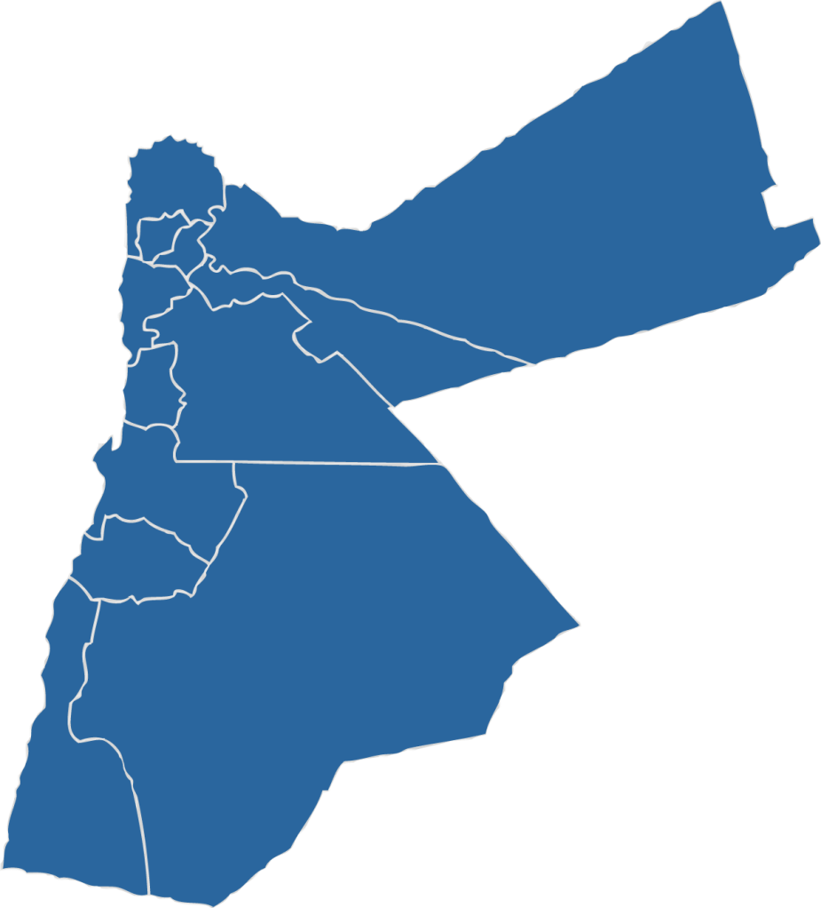
Development Zones designed to leverage the unique investment characteristics of every region
Irbid Development Area
Mafraq Development Area
0%
Dividends Tax
Jordan Development Area (Jabal Ajloun – Dead Sea)
0%
Income Tax on Exports
0%
Sales
Tax
0%
Import Duties
Amman Development Area
0%
Social Services Tax
Aqaba Special Economic Zone
Ma’an Development Area
5%
Income Tax

Slide 9
Development Zones
Aqaba Special Economic Zone
Logistics, Warehouses, Transportation, and Tourism
Jordan Development Area (Jabal Ajloun and the Dead Sea)
Tourism, Hospitality and Eco-tourism
King Hussein Business Park Development Area
Mixed-use Technology and Business Park
Irbid Development Area
KHBTDA (Mafraq)
IT/BPO Service and Healthcare
Ma'an Development Area
Industrial (Light And Medium) and Logistics Hub, Strategically Located Between Syria, Iraq, and Saudi Arabia
Industrial Park for Light, Medium and Heavy Industries; Ceramics, Plastics, Electrical Appliances and Renewable Energy.

Slide 10
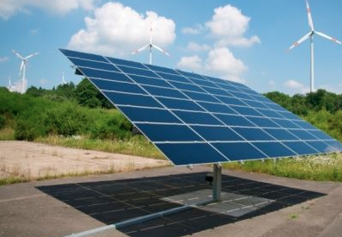
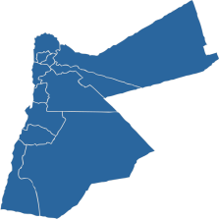
Energy & Renewable Energy
Jordan’s involvement in EU projects (MED-ENEC, MED- EMIP, MSP Mediterranean Solar Plan, EAMGMP, MED-Reg, MED-ENER)
Located within world solar belt; 300-320 days of full sunshine, with solar irradiation levels of 2600Kwh/m².
Wind speeds reach an average of 7 meters/sec in several locations.
40 billion tons of oil shale, 14 billion tons of silica, and 2% of the world’s uranium reserves
Among the highest engineers per capita ratios in the world; 1 engineer per 83 inhabitants in 2020.
Committed governance and pro-investment Renewable Energy and Energy Efficiency Law
Groundbreaking energy strategy with estimated investments of $1.4 to $2.1 billion in the sector.
Geopolitical advantage.
Grid connectivity to MENA and Europe regions
Business Opportunities: Photovoltaic cells Wind turbines and PV invertors Participant in turnkey projects Desalination projects
Industrial Zones, Development Zones
Irbid, Zarka, Amman

Slide 11
ICT Industry
Jordan is of the top 10 destinations worldwide for providing outsourcing activities. - Global Services Location Index, AT Kearney, 2009 Cisco, HP, Sun Microsystems, Orange, Intel Capital, Yahoo among others invested in Jordan
Total ICT revenue in 2014 reached USD 2.3 Billion
Jordan total ICT exports in 2014 reached USD 250 million where 85% of these exports targeted Arab countries.
Top export markets are the Saudi Arabia , Iraq, UAE, and USA.
Large labor pool of ICT professionals: Employment in the sector increased to 17,000 in 2014.
ICT tailored educational system from elementary to post graduate
Business Opportunities: Design studios for gaming and animation and localization of content. Equity funds (VC) to target growing IT start-ups in Jordan and the region (seed, growth and beyond). Customer Call Center. BPO/ITO Service Park an export hub for back-office business and IT services. Software Technology Park Financial sector IT solutions
Irbid Development Area
Business Park Development Area (Amman)

Slide 12
Pharmaceuticals and Clinical Trials
Merck Sharpe and Dohme, Aventis, Novartis and Pfizer, conduct clinical trials in conjunction with local CROs
Among the highest ratios of pharmacologists per 10,000 capita ratios in the world (14.1 compared to world average of 4.2, India at 5, US at 9, and KSA at 4) Source: WHO
Pharmaceutical exports reach more than 60 countries worldwide with more than 80 patents registered in Europe, the United States and Japan.
18 players with international certifications (1 listed on LSE).
Exports reaching $US 700 million in 2013,
30% less cost than Europe and USA in clinical trial testing.
Market driven legislations: Strict adherence to Intellectual property laws and enforcement
11 universities with medical subjects, 8 pharmacy colleges, 7 clinical research organizations (CROs).
World class Medical infrastructure: Jordan is the region’s medical treatment hub (ranked no.1 as medical tourism destination according to World Bank)
Business Opportunities: CROs New manufacturing plant. Under license manufacturing of antibiotics, anti ulcerants and niches Production of Herbal medicines from plant extracts R&D Facilities
Industrial Zones, Development Zones
Irbid, Zarka, Amman

Slide 13
Healthcare
Jordan is ranked 1st regionally and 5th internationally for medical tourism destinations Source: World Bank
Regional health destination of choice.
The revenue from Medical Tourism exceeded $US 1.7 billion in 2014, with over 250,000 foreign patients.
Jordan has 106 Hospitals, 6 of which are JCI accredited
Healthcare costs in Jordan are fraction of the cost of that in Europe and USA
The Dead Sea is located 400 meters below sea level, the lowest natural point on the surface of the earth.
The Dead Sea enjoys 8 % richer oxygen content than sea level, and lower levels of harmful UV ray penetration
Jordan has 22,000 physician and 5,094 dentist and 9,512 registered nurses.
Jordan has 26 doctors for every 10,000 persons
Business Opportunities: Medical Tourism Facilitators Ajloun Castle Health Spa Dead Sea Mineral Spa Medical College Children Cancer Hospital Dead Sea Cosmetics Mud Factories
Ajloun, Maeen, Dead Sea, Industrial Zone and Development Zones

Slide 14
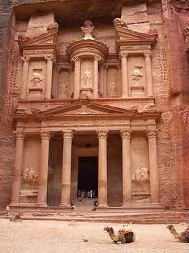
Tourism
Large number of world class hotels and facilities
The tourism sector contributed around 14% to the GDP in 2014
The total number of tourist arrivals was 4.9 million in 2014.
Roads, airports and ports connect Jordan to the region and the world
Jordan has 512 classified and non-classified hotels with 26,080 rooms beds 49,441
Jordan has 106 hospitals with 45,877 beds
New tourism focused development zones have been declared at the Dead Sea and Jabal Ajloun
Business Opportunities: Hotels (3, 4, and 5 stars) Theme Parks Water Parks Boutique Hotels Country Side Cottages
South of Jordan, Ma'an, Wadi Araba, Wadi Rum

Slide 15
Jordan offers a safe investment environment supported by…
A transparent regulatory framework and an attractive incentive structure. Furthermore you have strong and willing private sector partners that will support your entry into the Jordanian and regional markets.

Slide 16
Thank You

