Slide 1
Internet of things
Making technology work for
strengthening Arab-Greek economic partnerships
Yannis Theodoropoulos
Executive Vice President

Slide 2
The world
Awaits
Internet of Things is about enabling the “HYPERCONNECTED AGE”

Slide 3
TARGET
IoT CREATES “HIGH” RESOLUTION IMAGES
OF THE PHYSICAL WORLD
STATUS QUO
WE LIVE ON
“LOW RESOLUTION IMAGES”
OF THE PHYSICAL WORLD
INTERNET OF THINGS IS CENTRAL
TO DIGITAL TRANSFORMATION

Slide 4
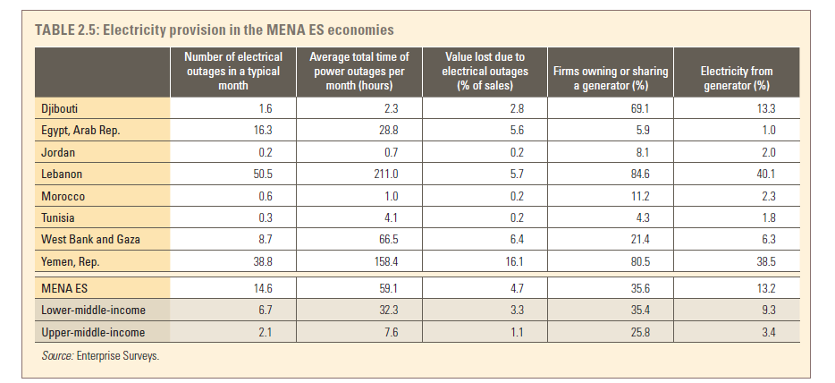
making ioT relevant
to the mena region
increasing competitiveness
through improved power supply
Strategic rationale
The development of IoT-based Energy Supply Chains would lead to reducing outages through the orchestration of demand and supply in real time, online.
Source: European Bank for Reconstruction and Development, the European Investment Bank, the International Bank for Reconstruction and Development / The World Bank - What’s holding back the private sector in MENA

Slide 5
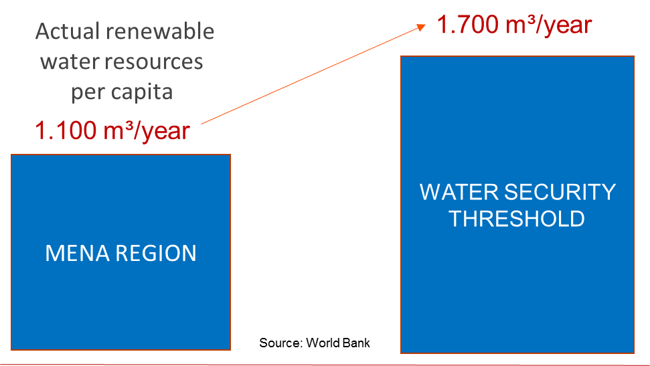
making ioT relevant
to the mena region
improving power supply
through water efficiency
Strategic rationale
MENA countries are using energy-intensive desalination processes for filling the water demand-supply gap. These processes contribute significantly to the power deficit of MENA region.

Slide 6
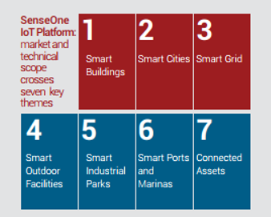
Singularlogic’s IoT FOOTPRINT – SELECTED USE CASES
Banking sector
Buildings Internet of Things solution for interoperability between heterogeneous assets and systems in 500+ sites: 24/7/365 portfolio-level monitoring and control of system-level inefficiencies through data sensing from legacy BMS systems, equipment and infrastructure
Industrial parks
Internet of Things solution for integrating industrial park assets through the installation of sensors and meters (AMR, energy, water/wastewater, pollution load meters), the collection, analysis and visualization of measurements in a unified database and the process automation for event-based alarms
Food retail
Integrated Energy Efficiency solution in 195 stores of a supermarket chain : 24/7/365 monitoring of refrigerators/HVAC/lighting, smart alarms for the early detection of abnormal energy use due to malfunctioning assets, energy consumption forecasting
NON-FOOD RETAIL
Store-level integrated solution for energy consumption and sustainability monitoring in 50 stores of leading non-food retail chain: centralized management of heterogeneous in-store BMS, in-store displays for web presentment of efficiency results, creation of energy baseline
Water utilities
Collection, processing and visualization of water flow data as well as alarms being generated from the combination of hetero-geneous water distribution infrastructure: 800+ water flow meters, pressure reducing valves (PRV) and flooding alarm sensors

Slide 7
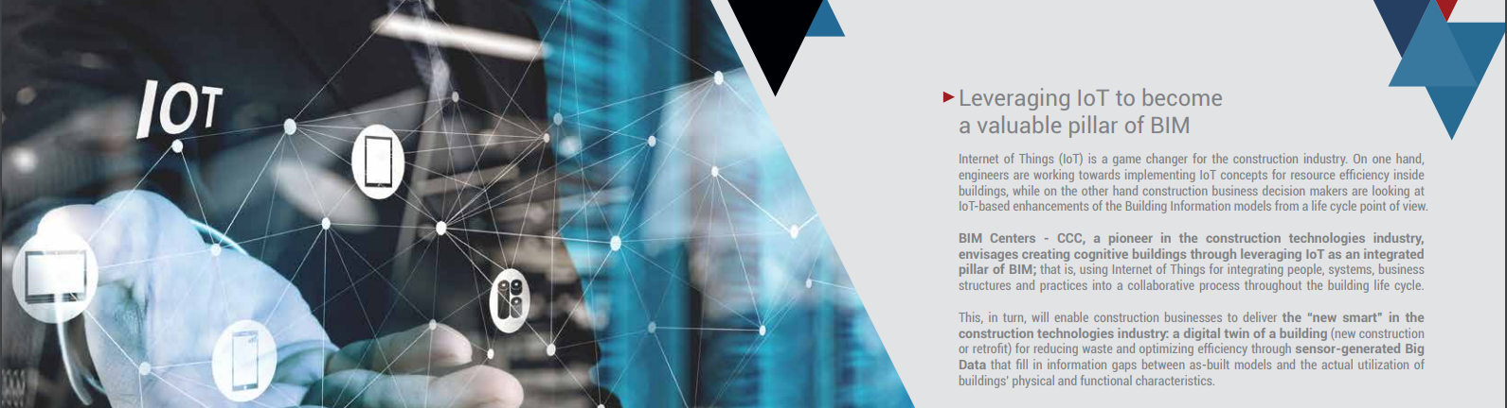
Cognitive buildings

Slide 8
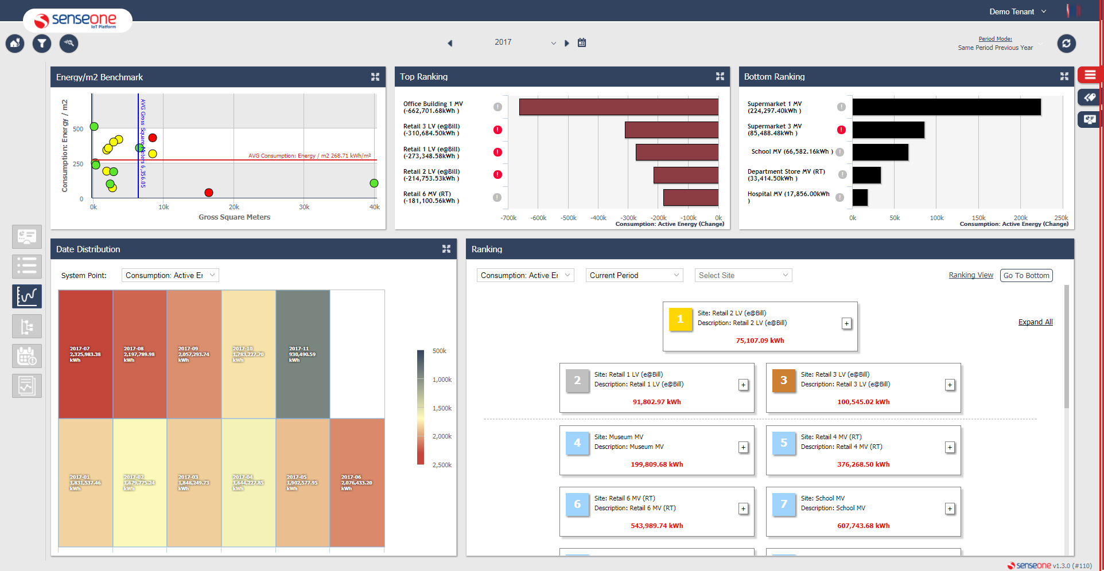
Resource efficiency
powered by
Energy
Water
equipment
Facilities management
Any metering infrastructure
Integrated solution
Any equipment, any device
Integration with 3RD party systems
Electricity, gas, heating oil
Water & wastewater mgt.
Hvac, Lighting, Building-integrated renewables
Building information modelling, building management & IT systems

Slide 9
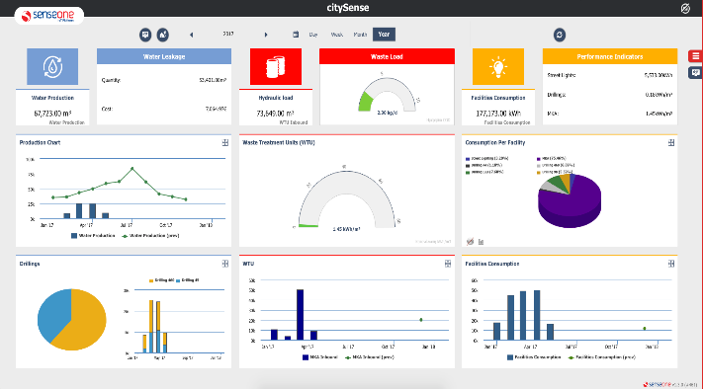
Smart cities
powered by
Smart grid
infrastructure
water
Smart operations
Energy monitoring
Connected Assets
Monitoring & control
Integration with 3RD party systems
Power generation
from renewables
Street lighting,
public buildings
Water distribution & wastewater management
Smart ports & marinas, airports, venues & sports arenas

Slide 10
Smart farming
Continuous crop monitoring with
continuous field data collection
Crop assessment for selective harvesting
Forecasting and scheduling of future harvests
Monitoring the fertilizing process
Μaping the cultivation state and the greenhouse conditions
Parasite and decease identification
.

Slide 11
Let's design
the Internet of things
world we want

