Slide 1
Digital & Technological Advancements
Shaping the new Economic reality

Slide 2
Linakis Vasilis
Partner @ Linakis Digital
Awarded digital agency focused on driving conversions via digital transformation best practices.

Slide 3
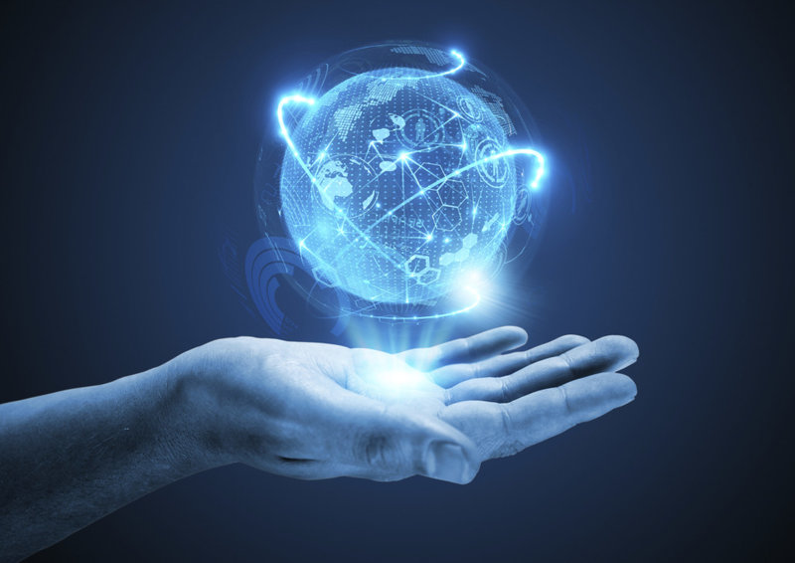
“In this world nothing can be said to be certain, except…”
Benjamin Franklin, 1789
Disruptive technology will revolutionize economy

Slide 4
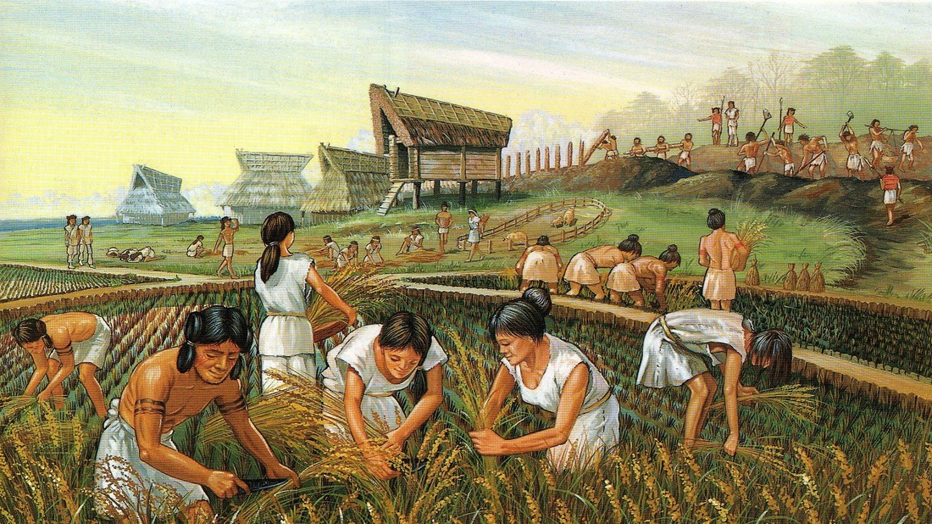
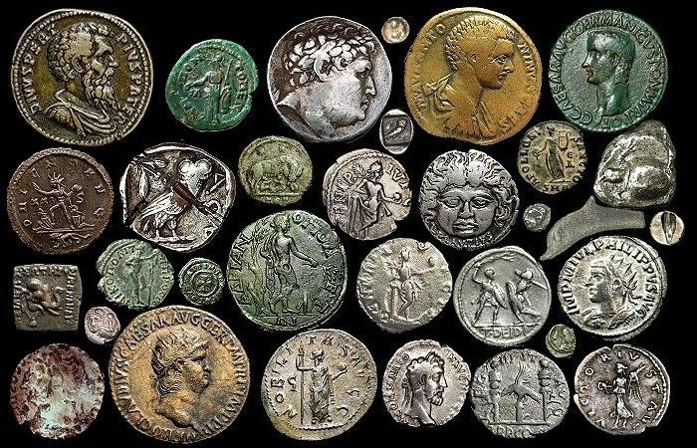
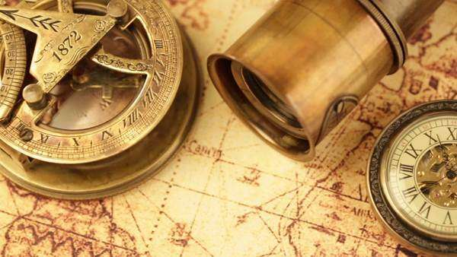
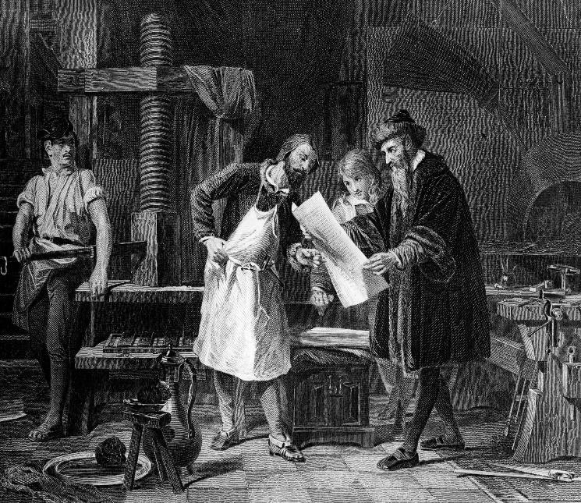
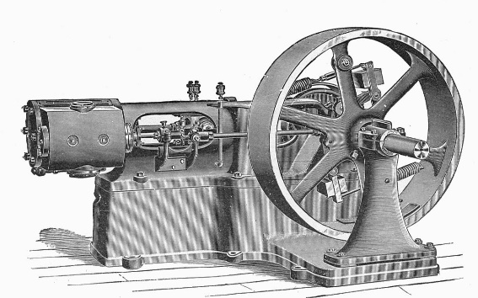
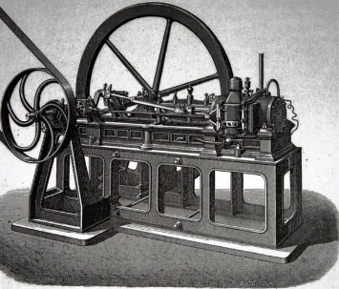
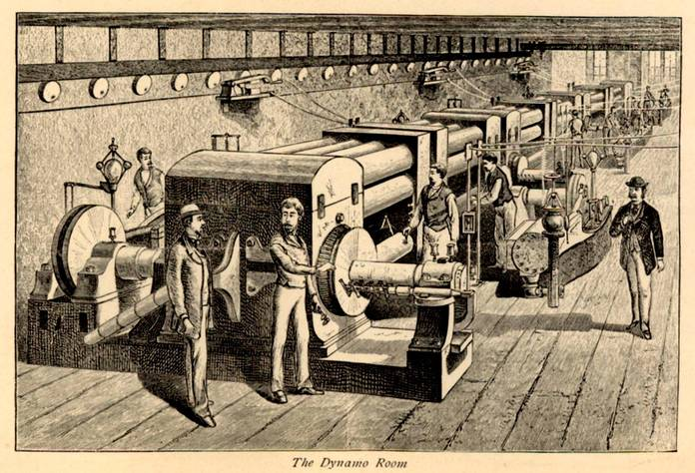
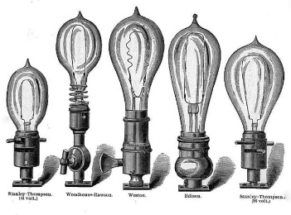
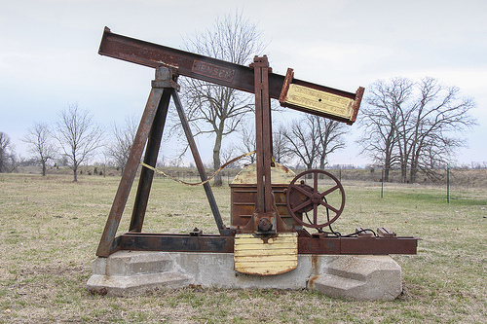
10000 B.C.
5000 B.C.
It has never stopped happening…
Neolithic agricultural revolution, Money
Accounting, Exchange Economy, Debt
Printing press
Business education, double-entry bookkeeping, interest rates, profit shares, exchange rates
1440 Gutenberg
Astrolabe, Magnetic Compass, Timekeeping
Age of Exploration, Globalization of trade
Steam engine, Railways
Industrial revolution, urbanism
1781 James Watt
Oil-based Internal combustion engine
Fuel-based economy, shift in geo-politics
1860 Etienne Lenoir
Electricity
Longer workdays, increased production, foundation for the information era
1882 Thomas Edison

Slide 5
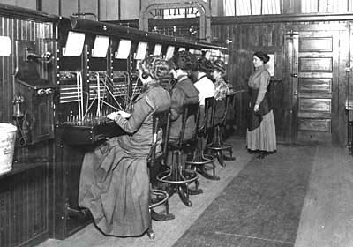
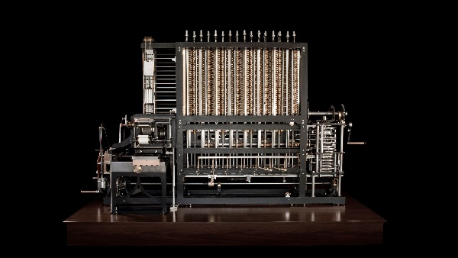
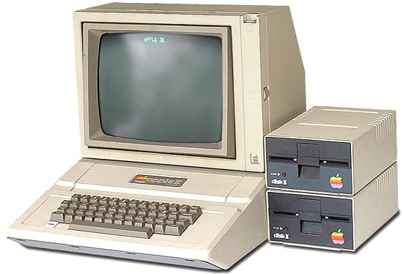
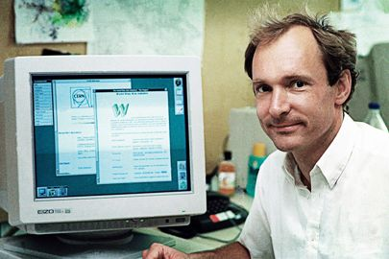
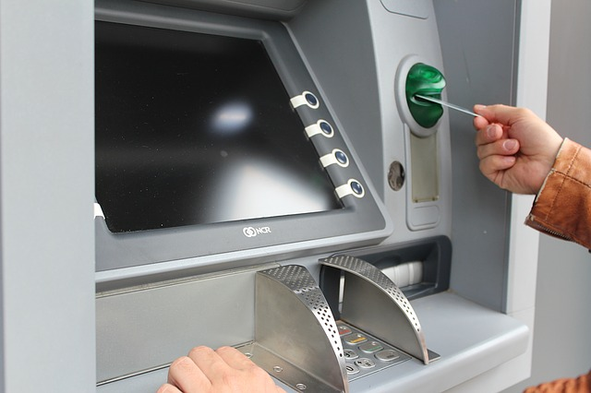
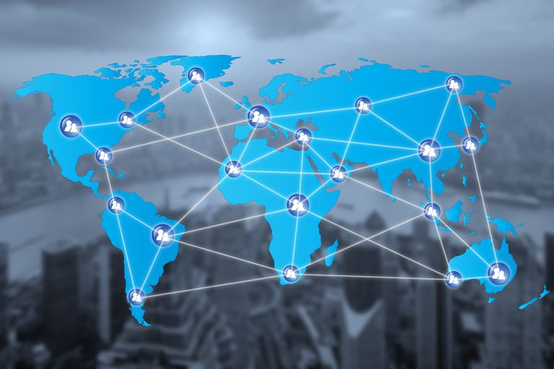
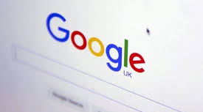
It has never stopped happening…
1846 Charles Babbage 1936 Alan Turing
Telegraph, Radio, Telephone
Global communication
Digital programmable computer
Shift from human-based to machine-based production
~1876, Morse, Marconi, Bell
Integrated circuits, Microprocessors
Smaller, faster computers, popularization of computing
Satellite communications, GPS
Global communications
Email, Internet, World-Wide-Web
Instant knowledge and information, worldwide transactions
Digital applications
Service-based economy, micropayments

Slide 6
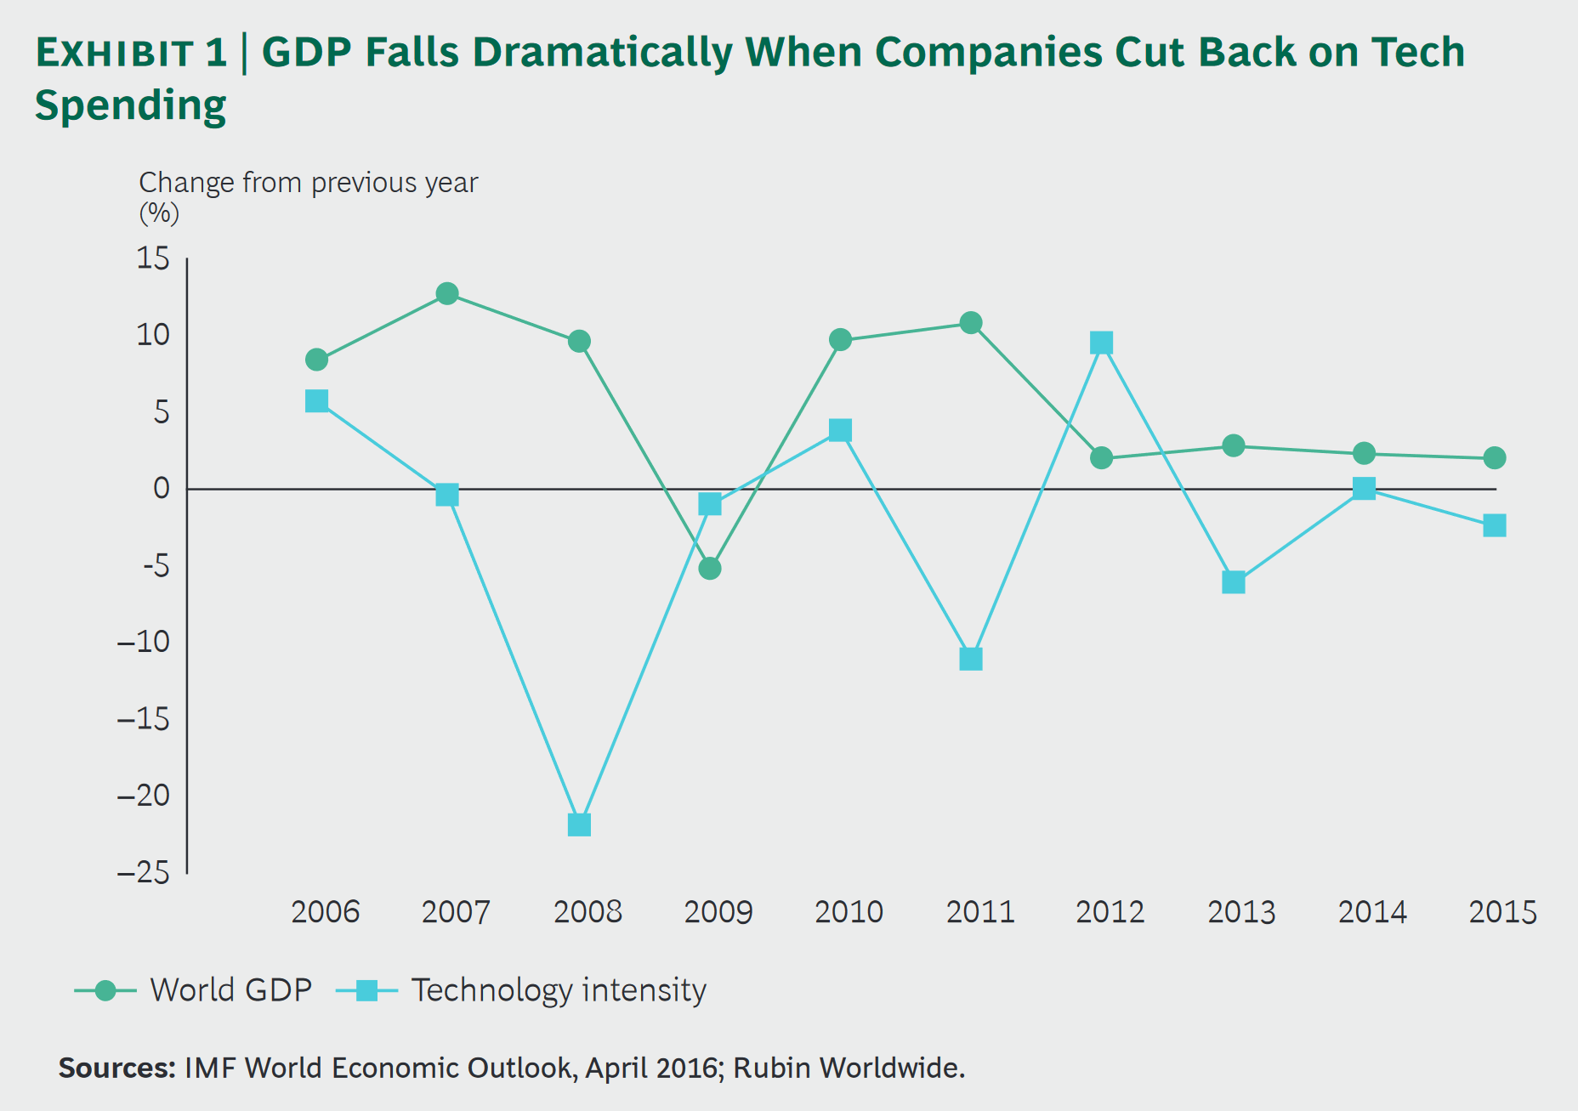
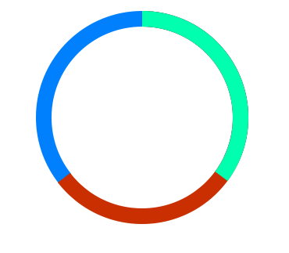
Measurable effect
The fluctuation in technology intensity that results from a change in technology spending causes the labor force to grow or shrink, which shows up in World GDP up to three years later.

Slide 7
Which technologies?
When will they happen?
How will they affect global economy?

Slide 8
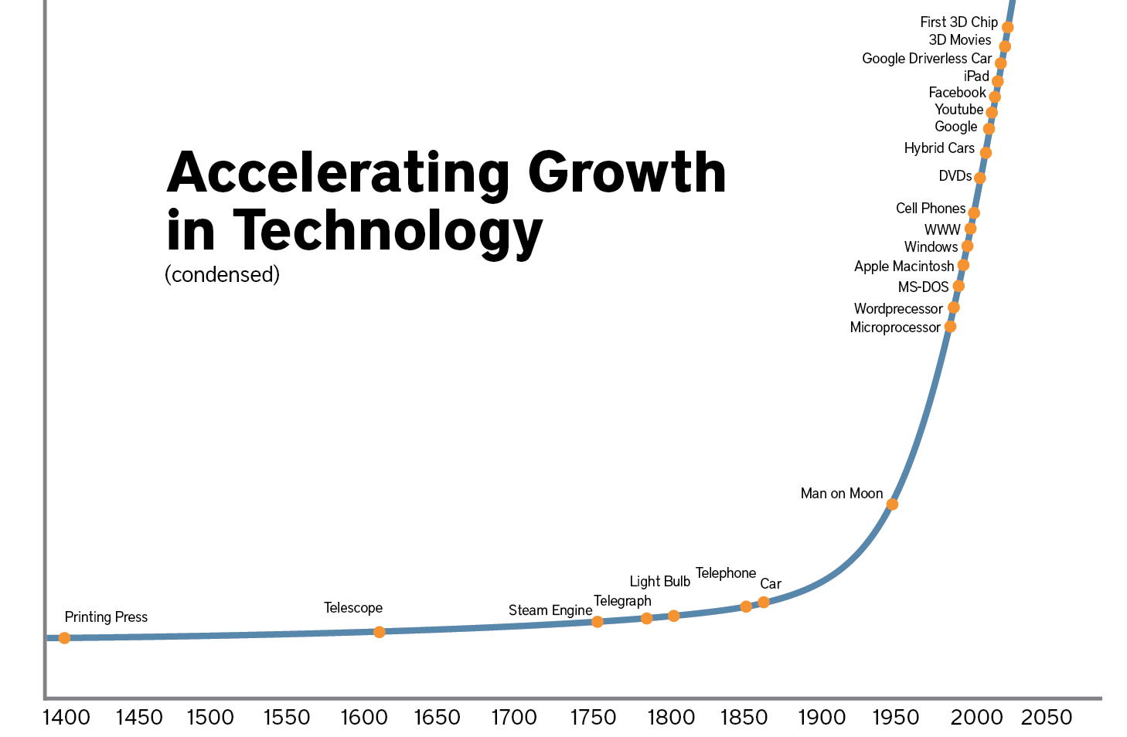
When?
“
We won’t experience 100 years of progress in the 21st century. It will be more like 20,000 years of progress.
”
Ray Kurzweil

Slide 9
Disruptive Technologies
Artificial Intelligence
Quantum Computing
Cryptocurrencies
Renewable energy
3D Printing
Interplanetary travel & colonization
Blockchain Technology
Which?
Nanotechnology
Genetics & Genomics
Self-driving Vehicles
Internet of Things
Robotics
Nuclear Fission
Deep space exploration
Virtual/Augmented Reality

Slide 10
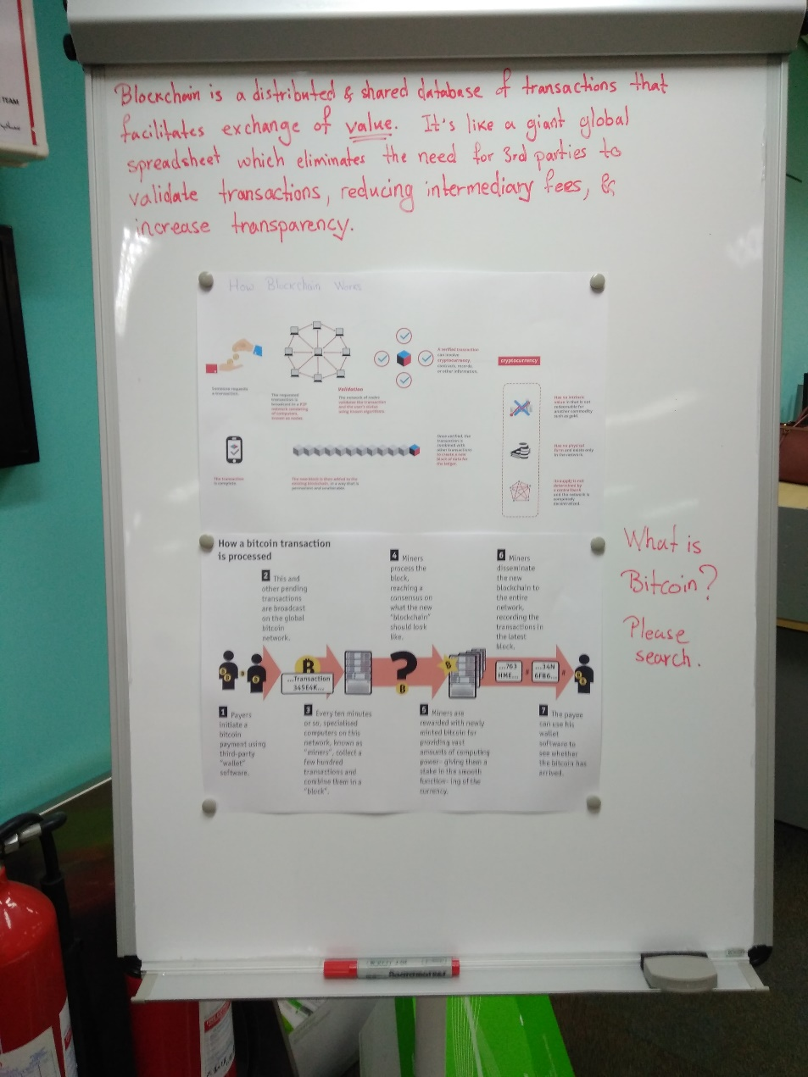
Blockchain Technology
An incorruptible digital ledger of economic transactions that can be programmed to record not just financial transactions but virtually everything of value
Current business ledgers
Inefficient
Costly
Νon-transparent
Subject to fraud and misuse
Due to reliance on centralized, trust-based, third-party systems
It is like a giant global spreadsheet, which eliminates the need for intermediaries to validate transactions (e.g. a central Bank).

Slide 11
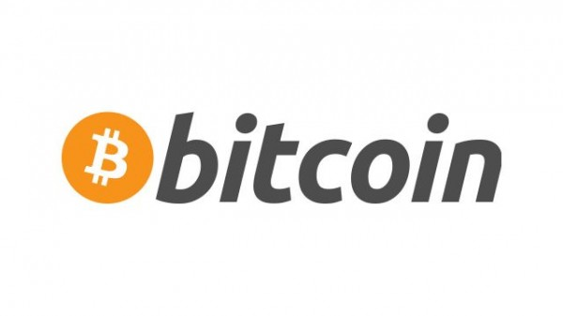
Blockchain – New Business applications
File storage
Decentralizing data throughout the network protects files from getting hacked or lost.
A worldwide cryptocurrency and payment system which is the first decentralized digital currency
Fraud protection and KYC
Know Your Customer costs could be reduced through cross-institution client verification, and at the same time increase monitoring and analysis effectiveness.
Crowdfunding
Peer-to-peer economy
Governance
Full transparency to corporate or state elections or any other kind of poll taking. or information.
Prediction markets
Crowdsourcing of predictions on event probability with a high degree of accuracy. Averaging opinions cancels out the unexamined biases that distort judgment.
Stock trading
Peer-to-peer, trade confirmations become almost instantaneous (as opposed to taking three days for clearance). Potentially, intermediaries get removed from the process (clearing houses, auditors and custodians).
Protection of intellectual property
Smart contracts can protect copyright and automate the sale of creative works online, eliminating the risk of file copying and redistribution.
Supply chain auditing
e.g. Verification of ethical claims made about products. Transparency comes with blockchain-based timestamping of a date and location that corresponds to a product number (e.g. ethical diamonds).
Land title registration
Property titles tend to be susceptible to fraud, as well as costly and labour intensive to administer. A number of countries are undertaking blockchain-based land registry projects.
Identity management
Distributed ledgers offer enhanced methods for proving who you are, along with the possibility to digitize personal documents.

Slide 12
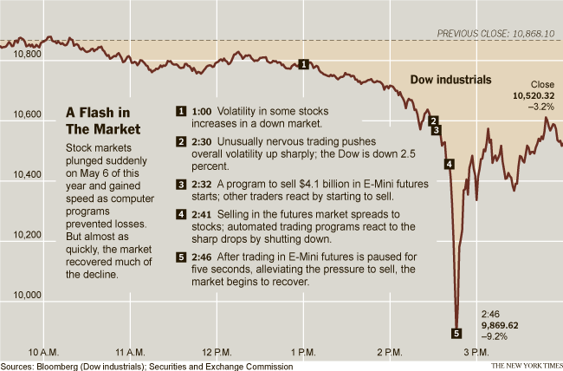
Artificial Intelligence & Robotics
Artificial Narrow Intelligence (ANI)
The computer specializes in one area
We are already living in a world running on ANI
Cars
Smartphones
Email spam filters
Personalized ads
Weather prediction systems
many, many more
2010 Flash Crash an ANI program caused the stock market to briefly plummet, taking $1 trillion of market value with it
(only part of which was recovered when the mistake was corrected)

Slide 13
Artificial Intelligence & Robotics
Artificial Narrow Intelligence (ANI)
The amino acids in the early Earth’s primordial ooze
Processing power
Human brain: 10 quadrillion cps
Tianhe-2: 34 quadrillion cps
Recursive self-improvement
A computer whose two major skills would be doing research on AI and coding changes into itself
Artificial General Intelligence (AGI)
A machine that can perform any intellectual task that a human being can
Artificial Superintelligence (ASI)
An intellect that is much smarter than the best human brains in practically every field, including scientific creativity, general wisdom and social skills.

Slide 14
Artificial Intelligence & Robotics
How far in the future are we talking about?
2017 Boston Dynamics

Slide 15
The challenge
Executives must become masters of the global “technology economy”, being capable of detecting the economic impact of such fast technological changes and respond with similar speed and foresight.

Slide 16
Thank You!
Linakis Digital
www.linakis.com
sales@linakis.com
t. +30 211 790 3100

Slide 17
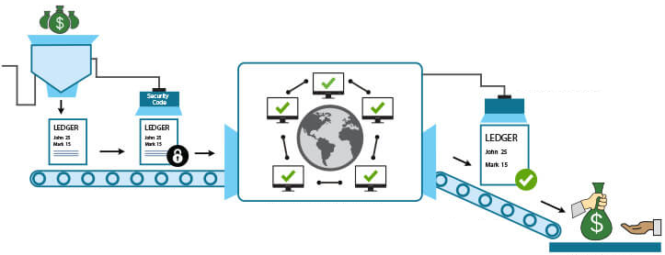
Anatomy of a Blockchain Transaction
VALIDATION
ENCRYPTION
DISTRIBUTION
The transaction is added to an online transaction ledger encrypted with a digital security code
The code of the transaction is sent to a large network, where it is confirmed without compromising private information and eliminating the need for a central authority
Once a transaction is confirmed and validated by several parties, it exists on the ledger of each as a permanent and immutable record on the transaction
The transaction information is recorded and the transaction is completed

Slide 18
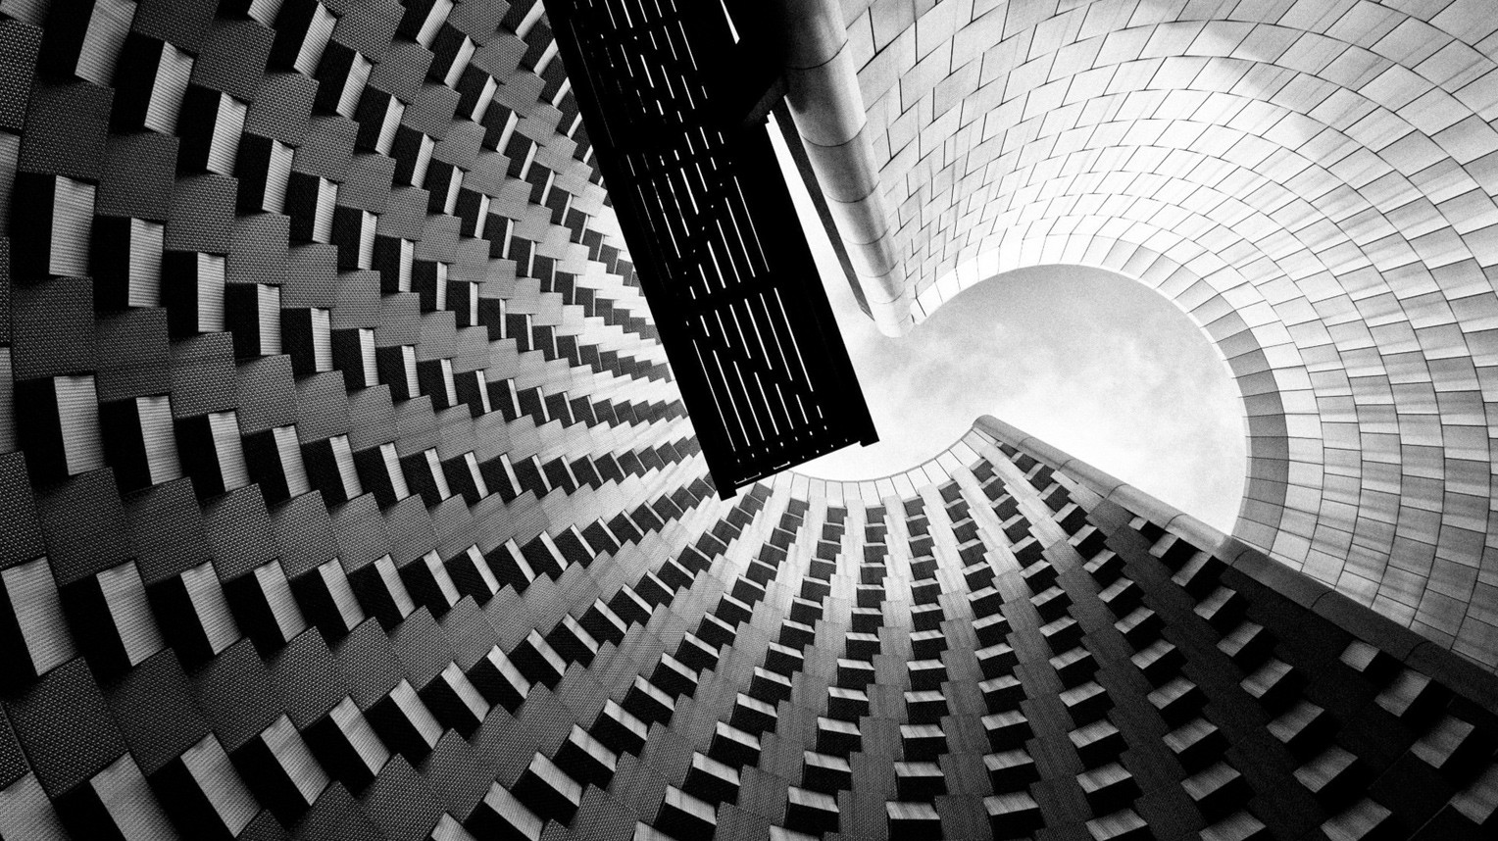
Approaching the “technological singularity”
The moment in the future when our technology’s intelligence exceeds our own…
…a moment when life as we know it will be forever changed and normal rules will no longer apply.

