Slide 1
Digital Economy

Slide 2
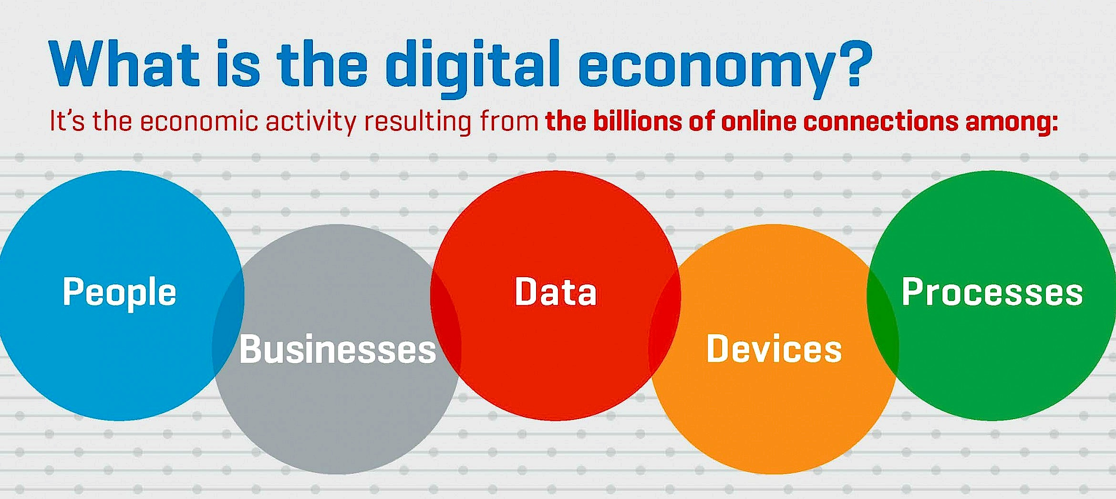

Slide 3
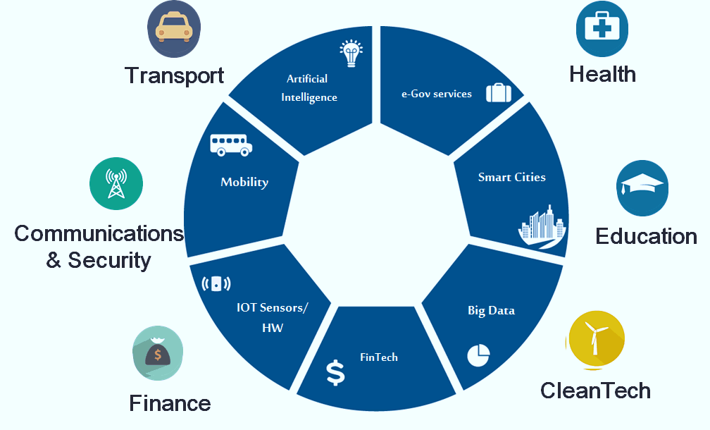
& Energy

Slide 4
Pillars of Digital Economy

Slide 5
Customer Expectations
Digital technologies enable better customer engagement.
However, Providing outstanding experiences to increasingly savvy customers is getting harder.
Customer expectations go beyond ease of use; they’re now expecting proactive experiences ( SMART SYSTEMS ).
Big Data is one of the enablers of proactive customer experiences.

Slide 6
Product Enhancements
SMART Products – Connected & Integrated
Harnessing the power of platforms
Connect buyers & sellers (Priceline, Apple’s App Store),
Connect hosts &visitors (Airbnb and HomeAway)
Connect drivers & riders (Uber, Lynx )
New On-Demand economy (UBER) - redefining the nature of work.

Slide 7
Collaborative Innovations
Collaboration is indispensable for innovation,
within the company’s own boundaries and beyond,
(customers, partners, startups, universities)
Harnessing Collaborative Digital Networks to build ecosystems,
(Amazon, PayPal, Apple, &Microsoft)
Collaboration and ecosystems are particularly important in the emerging Internet of Things,
(health care, home automation, and smart cities)

Slide 8
Organizational leadership
Must rethink company structures & culture to better deal with new market environments and business models.
Hierarchic Organization will not work in the fast-changing digital economy.
Inventing effective organizations for the digital economy is the grand challenge for our time,
Data-Based Decision making vs Opinion–Based
Organizational Learning. Artificial Intelligence, Robotics

Slide 9
Digital Economy Outcomes

Slide 10
Australian digital economy valued at $79b
Larger than Australia's agriculture, transport or retail industries
Estimated to grow rapidly, $139 by 2020 – 7% of GDP.
451,000 ICT specialists in Australia, 4% of total employment
Mostly working in manufacturing, construction, professional services, financial services, health and education

Slide 11
UK
Digital Economy Jobs at 1.56m growing at 2.8x times faster
41% of Digital Economy Jobs exist within traditionally non-digital industries
Digital Economy industries grew 32% faster than the rest of the economy (2010-2014)
Denmark
88% of Danish Internet users doing eBanking and 82% shopping online
Danish businesses make 15% of their turnover from online sales
25% of small and medium-sized companies in Denmark sell online
Sweden
32% Productivity contribution of the ICT-sector and the ICT-investments to the Swedish economy 1995 – 2005. contributed 42% to the total productivity growth between 2006 – 2013
ICT-sector accounted for 42% of total growth in labor over 1995–2013.

Slide 12
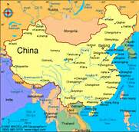
China - World largest e-Commerce Market
More than 40% of worldwide e-commerce transactions,
Up from less than 1% about a decade ago.
China – leading in mobile payments
11 x Transactions value of the USA
China’s three Internet giants building a rich digital ecosystem
Baidu, Alibaba, and Tencent, collectively known as BAT

Slide 13
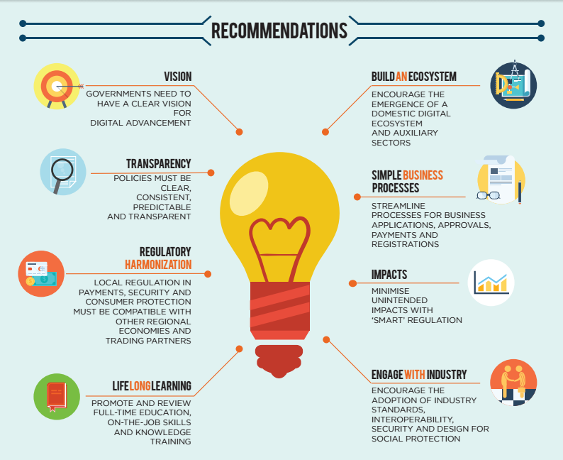

Slide 14
Jordan ICT Sector

Slide 15
REACH 2025
Concrete Actions toward
a Digital Economy.

Slide 16
“
A digital economy that empowers people, sectors and businesses to raise productivity and ensure growth and prosperity, creating a highly attractive business destination for investments and international partnerships.
”
REACH 2025 Vision Statement

Slide 17
Smart Specialization and Growth
Action 1 Adopting the Digital Economy Framework in Jordan’s economy
Action 2 Creating globally relevant, high value digital solutions and IP
Action 3 Driving global partnerships and bridges with international digital hubs

Slide 18
Public Sector Innovation
Action 4 Transforming government and public sector to be “digital by default” by 2020

Slide 19
Startups and Entrepreneurs
Action 5 Boosting digital economy startups in special zones
Action 6 Making Jordan the regional hub for makers
Action 7 Enabling a culture of digital entrepreneurship & intrapreneurship across Jordan

Slide 21
Skills, Capacity, and Talent
Action 8 Implementing 21st century skills to support the digital economy
Action 9 Creating a world-class talent pool to support and drive the digital economy demand locally and globally
Action 10 Creating models for better women participation in the digital economy

Slide 22
6%-8% overall GDP growth by 2025

Slide 23
25%-30% growth in digital sectors revenue by 2025

Slide 24
130,000-150,000 New digital jobs

Slide 25
5,000-7,000 new businesses in digital economy by 2025

Slide 26
Opportunity
Cross Regional Digital Economy
Threat
Worldwide Competition

Slide 27
Thank You

